Slide 1
Cleaning and Disinfection of Equipment and Instruments

Slide 2
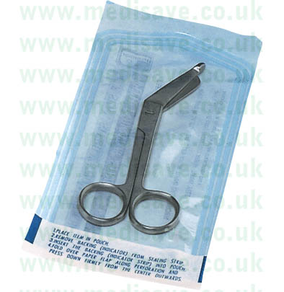
Sterilization and decontamination

Slide 3
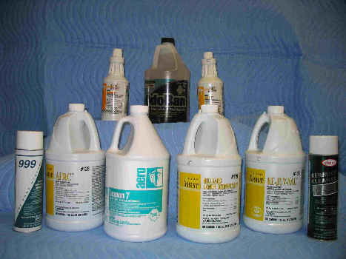
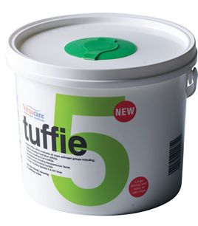
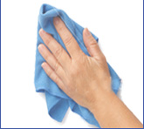
Levels of decontamination
Cleaning
Disinfection
Sterilisation

Slide 4
Cleaning
Removes micro-organisms by using detergent.
Important for the successful application of standard and additional precautions.
Detergents used for environmental cleaning should be based on the facilities policies and procedures.

Slide 5
Cleaning instruments and equipment
The most important aspect of controlling microbial growth is cleaning.
Bacteria thrive in moist organic matter such as tissue, blood, body fluids, soiled linen, dressings, food and garbage.
Organic material, grease and dirt act as a protective barrier for micro-organisms and prevent penetration of a bacteriocidal agent.
If an item is not cleaned effectively sterilisation may be compromised.

Slide 6
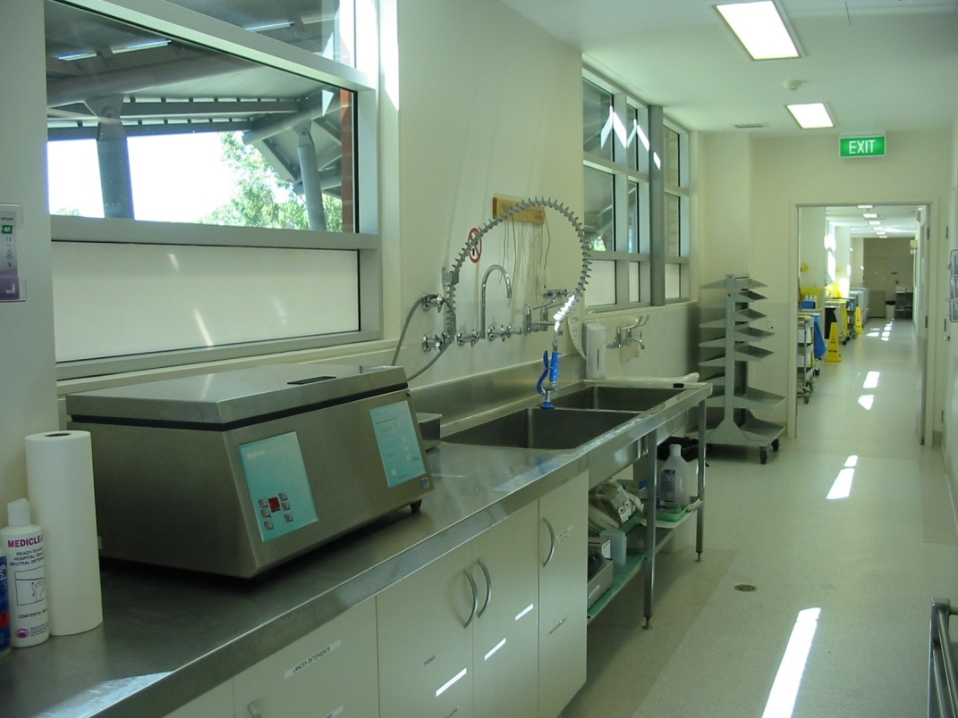
The washing of equipment will not kill all bacteria but will reduce the number of bacteria thereby enhancing the effectiveness of the disinfectant / sterilizing agent.

Slide 7
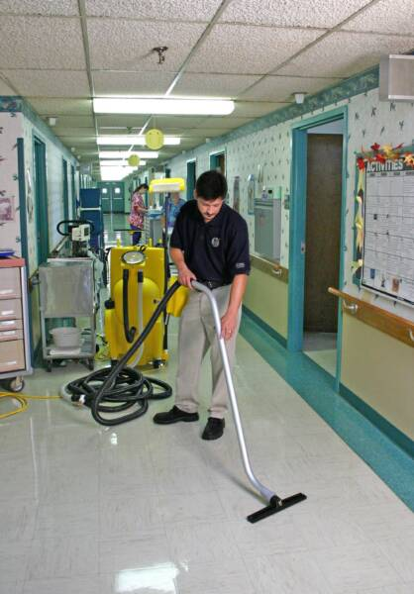
Environmental cleaning
Cleaning of wards, bathrooms, floors and equipment is an important part of infection control.
There are specific health care facility guidelines for the cleaning of rooms and equipment, in particular specific guidelines for cleaning in the presence of MRSA and other diseases.

Slide 8
Disinfection
Disinfectant – an agent that Kills or inactivates large numbers of micro-organisms but does not sterilse.
Reduces the number of microbes to an ‘acceptable’ level.
The ‘acceptable level depends on the purpose for which the article is to be used. E.g. a bedpan vs respiratory equipment.
Chemical disinfectants and sterilants act by damaging the structure or impairing the metabolism of micro-organisms.
Agents used in the health care setting are regulated by the Therapeutic Goods Administration (TGA)

Slide 9
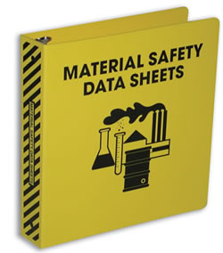
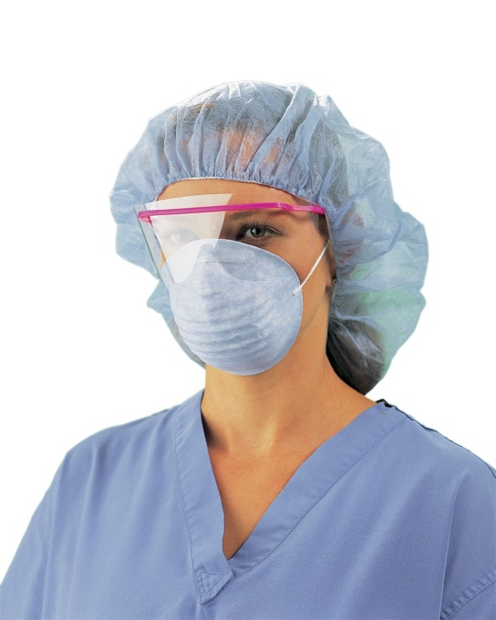
There are a number of points to remember when using disinfectants:
Storage
Expiry
MSD sheets
Mixing
Application
Concentration
PPE
Spills / clean up

Slide 10
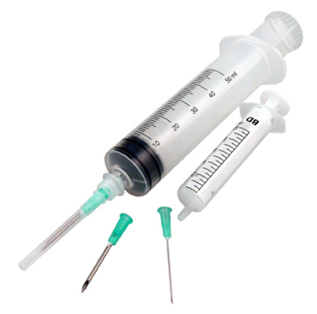
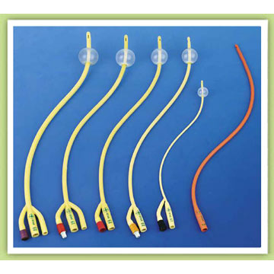
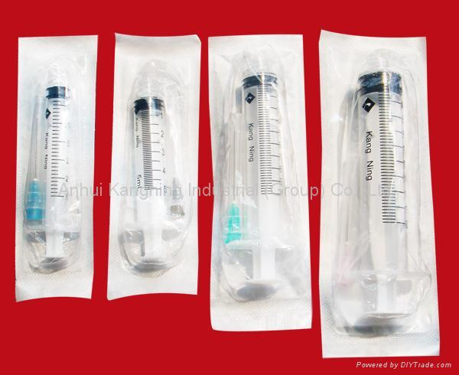
Single use only equipment must be discarded after one use.
Decisions regarding cleaning, disinfecting and sterilisation of items can only be made by a suitably qualified person such as the Infection Control Nurse, in consultation with organisational policy and procedures.
Consultation with a microbiologist may be required.

Slide 11
Sterilisation
Sterile : completely free of all micro-organisms and their spores.
The destruction of all living organisms from an object
An object is either sterile or non–sterile it can not be partly sterile!

Slide 12
Methods of sterilisation
Heat – dry and moist
Moist heat
Moist heat e.g. bed pan flusher – up to 100c but viruses such as Hepatitis A can survive this.
Most reliable method of moist heat sterilisation is by Autoclave – steam under pressure.

Slide 13
Dry heat
Requires a temperature of 180c for 60 minutes. Hot air ovens for items not damaged by long exposure to high temeratures e.g glass and some metal objects.
Time factors for heating and sterilising make this less practical than autoclave.
High temperatures required is a limitation due to fabrics and wrapping materials unable to withstand the heat.

Slide 14
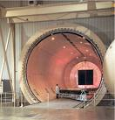
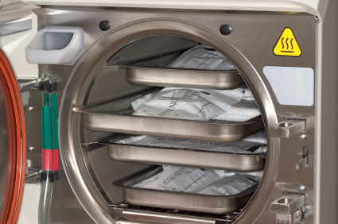
Autoclave

Slide 15
Double walled chamber made of thick steel
Steam circulated through the outer chamber and supplied under pressure to the inner chamber.
Higher the pressure the higher the temperature of the steam.
Steam must contact every part of the object.
Used for: glass surgical lines and metal objects (surgical instruments and basins).

Slide 16
The equipment is wrapped in material (special paper or fabric) that is able to withstand the high temperatures and maintain sterility after removal from the steriliser. Special tapes and indicators are applied.
Equipment is not layered as this will prevent steam accessing all surfaces.
Load allowed to dry inside the autoclave.
Sterilised items are handled and stored carefully.
Autoclave tested regularly using a bacterial spore specimen and observation of growth after sterilisation, no growth= correct function of autoclave.

Slide 17
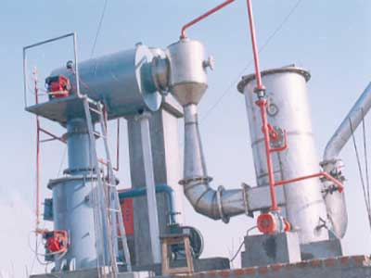
Incineration
Used to completely destroy micro-organisms in biological materials, contaminated wastes, soiled dressings and disposable equipment.

Slide 18
Radiation
Ionising radiation kills micro-organisms or disrupts the structure of DNA.
Used to sterilse disposable equipment such as dressing packs, needles, syringes, suture materials, catheters and prosthesis.
Carried out in a specialised facility.
Packaged first and then sterilised.

Slide 19
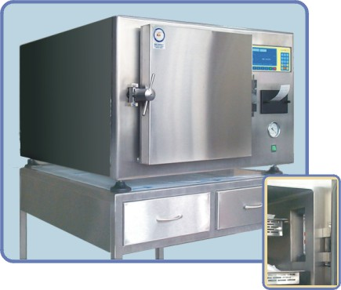
Ethylene Oxide Gas
Highly toxic – carcinogenic, teratogenic, mutagenic.
Effective against all micro-organisms
Colourless
Explosive when mixed with O2
Careful control in a specialised facility
Used for pre-wrapped packages of disposable / delicate equipment otherwise harmed by heat and liquid – articles made of rubber and heat sensitive items.

Slide 20
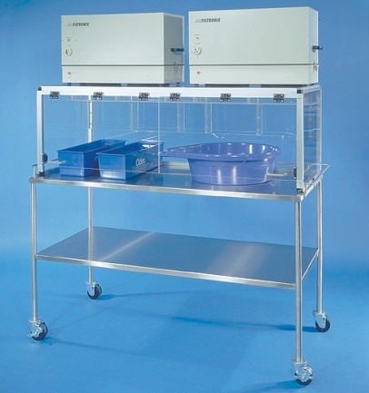
Gluteraldehyde
Non corrosive chemical
Active against a number of micro-organisms
Toxic
Allergenic
Unstable – retains activity for a few weeks or number of uses.
Strict safety guidelines
Recommended only when no other substance is suitable e.g. for fibre optic endoscopes.

Slide 21
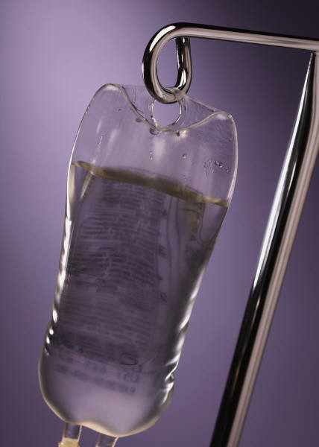
Filtration
Removal of micro-organisms from liquids or gases by passage through a filter with pores small enough to retain micro-organisms.
Used for aqueous solutions; surgical irrigation, IV therapy, dialysis solutions, TPN.

Slide 22
Hydrogen Peroxide Plasma Sterilisation
Active against wide variety of micro-organisms including viruses and spores
Non toxic
Low temperatures
Rapid (approx 75mins)
But requires all items to be wrapped in non-cellulose wrap
Mainly used in sterilising department of larger hospitals.
Used for moisture sensitive equipment – electronic equipment, fibre optic cables, camera heads.

Slide 23
Thank You

