Slide 1
Segregation and Disposal of All Hospital Waste

Slide 2
Waste handling and disposal
• Manual handling of waste should be avoided
• Apply standard precautions to protect against exposure to blood and body fluids during handling of waste; wash hands following procedure
• Clinical waste must be contained in leak-proof bags or containers. These must not be over-filled or compacted by hand
• Waste should be contained in the appropriate receptacle (identified by colour and label) and disposed of according to the facility waste management plan
• Waste handlers should be trained in how to manage spills of clinical waste.

Slide 3
Waste
General waste
Contaminated waste
Sharps
Aerosol cans
Pharmaceutical / chemical
Cytotoxic waste
Infectious waste

Slide 4
All waste is collected by companies who offer a waste disposal service, the incineration of waste is the responsibility of the Environmental Services Dept under the direction of the wastes officer, incineration facilities are licensed by the EPA (environmental Protection Agency).
Items that must be incinerated are:
Infectious waste
Pharmaceutical waste
All sharps

Slide 5
There is a standardization of colours for waste disposal which allows for identification and compliance with specific disposal guidelines

Slide 6
General waste green plastic
Contaminate waste black plastic
Infectious waste yellow plastic (biohazard sign)
Cytotoxic waste purple plastic
Residents clothing blue Terylene reusable bags

Slide 7
Infectious waste
Any substance containing micro-organisms posing a substantial threat to the health of human beings or the environment due to their volume or virulence;
all sharps are regarded as infectious waste, sharps containers are rigid yellow plastic.

Slide 8
Cytotoxic waste
Includes:
Cytotoxic drugs
Needles and syringes used in the treatment
IV sets
Ampoules / vials
Disposable gloves, gowns, caps and swabs

Slide 9
The method of disposal is different from other kinds of waste;
cytotoxic waste is disposed of by controlled high temperature incineration.
Cytotoxic waste warning signs should be displayed at the patient’s bed head, sharps box, cytotoxic waste bag and cytotoxic waste carton.

Slide 10
Sharps
Placed in hard walled sharps container (purple) or yellow sharps container with cytotoxic label attached.
Containers taped down and placed in purple cytotoxic waste bag, taped closed, identified with cytotoxic waste label and collected by environmental services staff.

Slide 11
Linen
Non contaminated linen is treated as normal linen.
Contaminated linen is double bagged into alginate bag and then into yellow linen bag, not placed with general linen, stored separately for collection and staff advised that it is contaminated cytotoxic linen.

Slide 12
Leakage from cytotoxic waste is identified and cleaned up using the correct protocol immediately.
A spillage kit must be on the ward before administration of chemotherapy.

Slide 13
If you are contaminated with cytotoxic waste / chemical / drug
Follow the correct hospital policy and procedure
Wash / shower immediately
Contact supervisor
Change contaminated clothing
Complete incident form

Slide 14
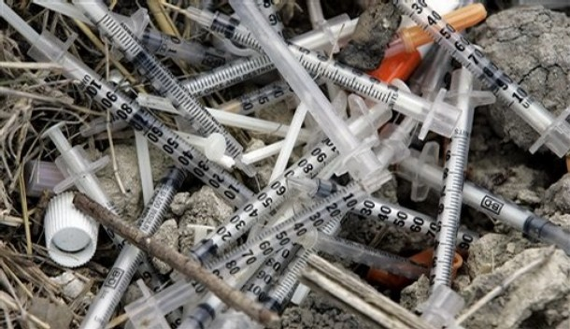
Clinical and Related Wastes
Management must conform to relevant State/Territory regulations.
Waste should be segregated at the point of generation, using appropriately colour-coded and labeled containers.
HCW’s must wear gloves and protective clothing when handling clinical and related waste bags and containers.

Slide 15
Clinical waste includes :
Discarded sharps
Laboratory and associated waste directly associated with specimen processing Human tissues, including material or solutions, blood and animal tissue or carcasses used in research.
Related waste includes:
Cytotoxic waste
Pharmaceutical waste
Chemical waste
Radioactive waste

Slide 16
Clinical waste must be placed in yellow containers bearing the international black biohazard symbol and clearly marked as ‘clinical waste’.
Cytotoxic waste must be placed in purple containers and marked as ‘cytotoxic waste’.
Radioactive waste must be placed in red containers with the black international radiation symbol and marked as ‘radioactive waste’.

Slide 17
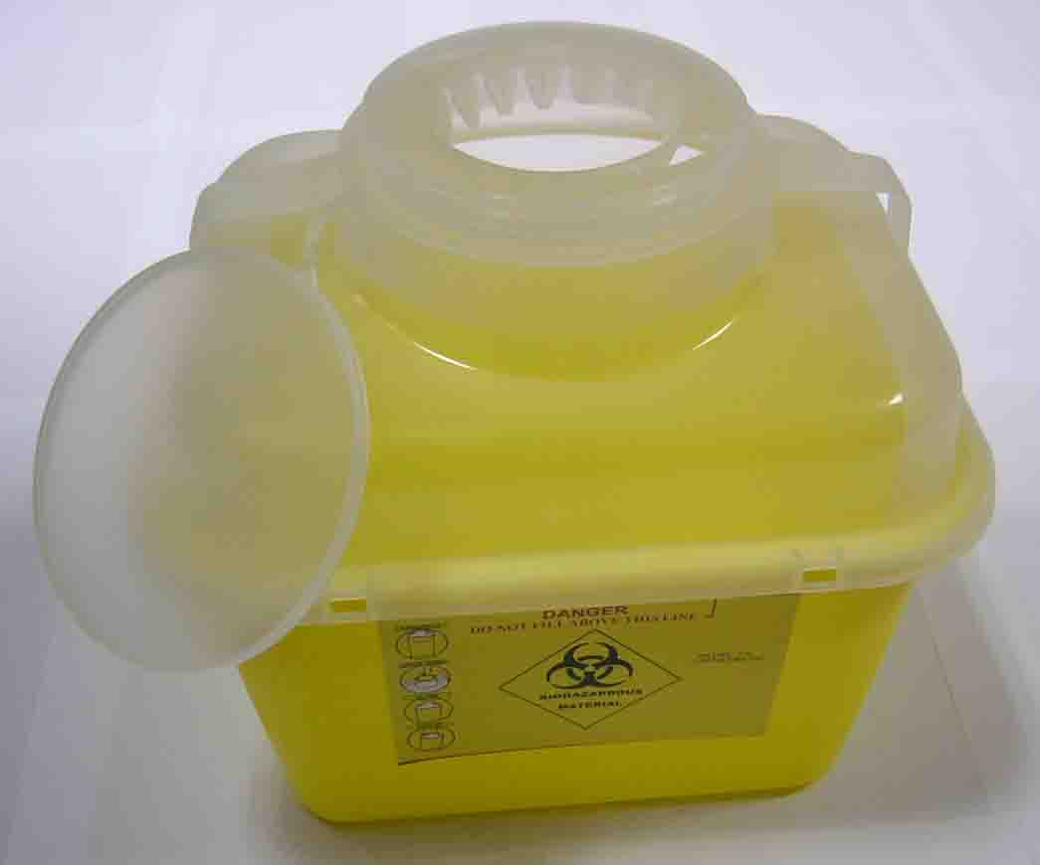
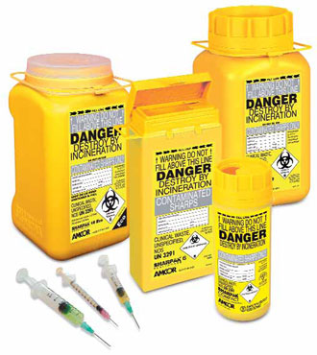
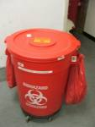
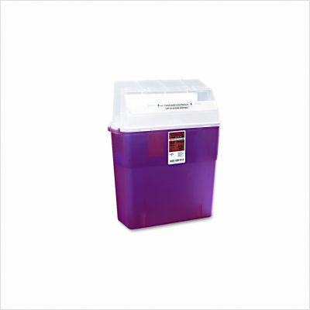

Slide 18
Hazard management for cytotoxic drugs and related waste
Follow policy and procedure
Education and training
Correct use of equipment
Report and record any exposure – accident investigation
Maintain standard precautions

Slide 19
Update new technologies or medications
Long sleeve gown (impervious), gloves, goggles for IV admin
Appropriate administration by a Registered Nurse
Extravasation and spill kits plus instructions kept on site
Unused drugs to be returned to pharmacy
No touch techniques
Appropriate use of PPE

Slide 20
Sustainable Practices
Option | Example
Avoid creating waste | Ask suppliers not to package the goods they provide, where appropriate
Re-use waste | If goods have to be packaged, ask the supplier to take back the packaging
Recycle waste | Use packaging for storage
Recover energy from waste | Burn waste in a legal incinerator to heat water for council or community use
Dispose of waste safely | Bury waste in a council landfill/rubbish tip

Slide 21
Thank You

