Slide 1
Bed Making - Occupied

Slide 2
DEFINITION OF TERMS
1.1 Bed making
the ability of the nurse to keep the bed clean and comfortable
the technique of preparing different types of bed in making patients/clients comfortable in his/her suitable position for a particular condition
it requires keen inspection to be sure that the linens are clean, dry and wrinkle-free
1.2 Fanfold
is done by grasping the upper edge of the linen with both hands
specifically folding the edge of the sheet used in the bed 6-8 inches outward
1.3 Mitered corner
a means of anchoring sheets on mattresses
method of folding the bed clothes at the corners to secure them in place while the bed is occupied
it is accomplished on the bottom sheet by placing the end of the sheet evenly under the mattress
1.4 Toe pleat
a fold made in the top bed clothes to provide additional space for patient’s toes

Slide 3
DEFINITION OF TERMS
1.5 Foot drop
dropping of the foot from paralysis of the anterior muscle of the leg
plantar flexion of the foot with permanent contracture of the gastrocnemius (calf) muscle and tendon
1.6 Bed cradle
is a curved, semi-circular device made of metal that can be placed over a portion of the patient’s body
is sometimes called an Anderson frame, is a device designed to keep the top bedclothes off the feet, legs, and even abdomen of a client
1.7 Magic corner
corners of a folded linen when upon opening it automatically positions the sheets the way it is placed on the bed

Slide 4
PURPOSE OF BEDMAKING
A. On changing an unoccupied bed
to promote the client's comfort
to provide a clean near environment for the client
to provide a smooth, wrinkle-free bed foundation, thus minimizing sources of skin irritation
B. On changing an occupied bed
to conserve the client's energy and maintain current healthy status
to promote the client's comfort
to provide a clean near environment for the client
to provide a smooth, wrinkle-free bed foundation, thus minimizing sources of skin irritation

Slide 5
IMPORTANCE OF BEDMAKING
It helps maintain a clean, orderly and comfortable room which contributes to the patients sense of well-being.
Helps the patient secure proper rest and comfort which are essential for health and refresh him/her by providing cleanliness
It helps prevent or avoid microorganisms to come in contact with the patient which could cause tribulations.
It minimizes the sources of skin irritation by providing smooth, wrinkle-free bed foundation.

Slide 6
TYPES OF BED
Bed
- is primarily divided into 3 sections
length: 1.9m (6.5ft).
weight: 0.9m (3ft.)
high: 66cm (26in.)
but sometimes varies depending on circumstances
A. Common Types of Bed
Occupied bed
the occupied bed is made when the patient is not able or not permitted to get out of the bed
the important part of making an occupied bed is to get the sheets smooth and tight under the patient so that there will be no wrinkles to rub against the patient’s skin
the client’s privacy, comfort and safety is also important when making the bed

Slide 7
TYPES OF BED
2. Unoccupied bed
the unoccupied bed is made when there is no patient confined in bed
A unoccupied bed may be:
A. Open bed
the top covers are generally folded back so that a client can easily get into bed
surgical, recovery and postoperative bed is a modified version of the open bed; the top bed line is arranged for easy transfer of the client from a stretcher to the bed
the top sheets are folded to one side or fanfolded to the bottom third of the bed
B. Close bed
the top sheet blankets and bedspreads are drawn up to the head of the mattress and under the pillows, this is prepared in a hospital room before a new client is admitted to that room

Slide 8
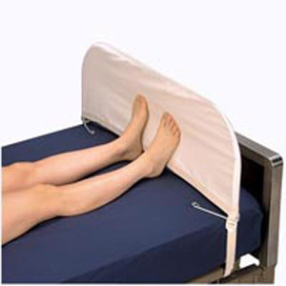
TYPES OF BED
C. Cradle Bed
Contains cradle, a device for holding the top covers off.
The outer cradle is made of wood, metal or at home for a brief period, a cardboard art to shape.

Slide 9
TYPES OF BED
D. Postoperative Bed
Also known as recovery bed or anesthetic bed.
Used not only for clients who have undergone surgical procedures but also for clients who have given anesthetics for a certain examination.
Used for a patient with a large cast or other circumstance that would make it difficult for him to transfer easily into bed.

Slide 10
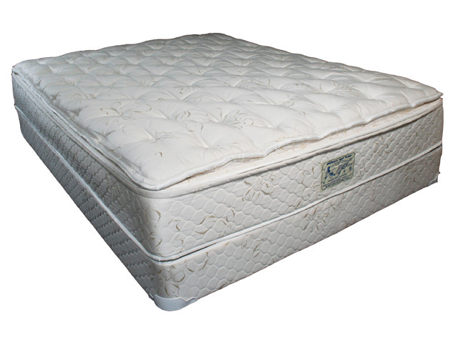
TYPES OF BED
B. Special Types of Beds
Water bed
Special mattress filled with water.
It controls temperature of water reducing pressure on body parts.
Indications:
Patients confined to bed for long periods

Slide 11
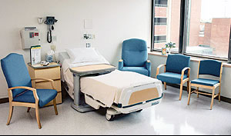
TYPES OF BED
2. Turning Frames (Stryker Wedge)
It allows repeated changes between the supine and prone positions without disturbing spinal alignment.
Indications:
complication of immobility such as atelectasis, pneumonia, decubitus ulcer and renal calculi.

Slide 12
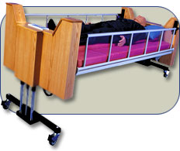
TYPES OF BED
3. Rotation Bed
promote postural drainage, peristalsis and helps prevent the complications of mobility
Indication:
patients with spinal cord injury, severe burns

Slide 13
TYPES OF BED
4. Circolectric Bed
Permits frequent turning of several injured or immobilized patient with minimal trauma or extraneous movement.
Helps prevent and treat pressure ulcers, respiratory and circulatory complications
Indications:
Patients confined to bed for long periods of time

Slide 14
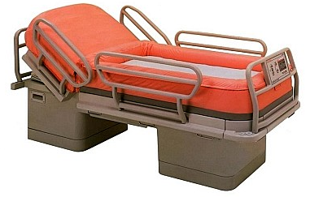
TYPES OF BED
5. Clinton Therapy Bed
Also called the air-fluidized bed
Designed for managing burns and patients with various disabilities.
Indications:
Patients with managing burns and patients with various disabilities.

Slide 15
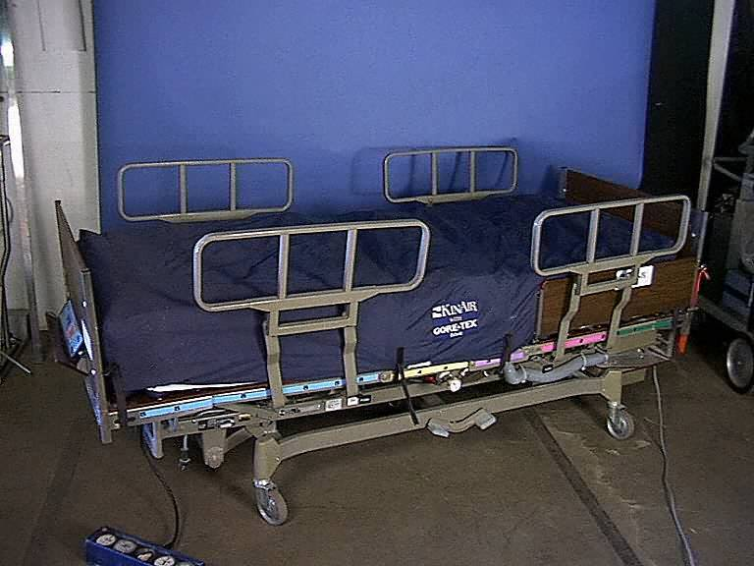
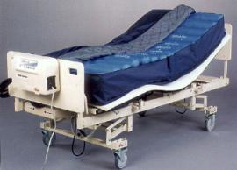
TYPES OF BED
6. Air Therapy Bed
For patients who have risk skin breakdown
Provide different levels of support to different body parts.
Indications
Patients who are at risk to skin breakdown

Slide 16
COMMON BED POSITIONS

Slide 18
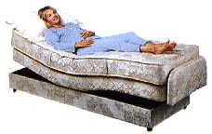
Contour
Head section is elevated; the knee and foot section are elevated.
Indications: used for certain injuries or disease of the lower extremities.

Slide 19
PRINCIPLES IN BEDMAKING
BODY MECHANICS
it is important to the nurse to observe the correct body mechanics in order to prevent quick tiring, back problems and muscle pain.
ANATOMY & PHYSIOLOGY
the conscious knowledge of the normal state and condition of certain parts of the body wherein one would be able to tell any abnormality.
the body exerts uneven points of pressure against different areas of the mattress. The sacrum may become the site for pre-assure sore because of the weight of the patient’s body and a reduced blood supply to the tissues over bony prominence.
CHEMISTRY
woolen blanket fibers may cause irritation to the patient’s skin; there must always be a sheet to separate the blanket from the patient
strong detergent, soap and bleaches used in commercial laundries may cause skin irritation if bed linens are not thoroughly rinsed

Slide 20
PRINCIPLES IN BEDMAKING
MICROBIOLOGY
pathogenic microorganism may be transferred from the source to a new host directly by contaminated linen. Hands should be washed before and after making bed.
bed linen should be folded away from the body to minimize the transfer microorganism to the clothing
fanning bed clothing stirs up bacteria in the air, and air motion is a method of transfer.
PHYSICS
friction can irritate the skin and cause rashes. It is therefore appropriate to keep the lines smooth and wrinkle-free.
stability of body (center of gravity over its base)
PSYCHOLOGY
use skill and efficiency in making the bed to minimize undue exertion and fatigue for the patient. If the procedure brings comfort and relaxation, his attitude will improve.
SOCIOLOGY
the nurse should know how to talk to patients. The nurse should also know the subject of conversation which interests the patient including his condition, family, and work.

Slide 21
KINDS OF LINENS
Blanket
a large piece of cloth often soft, woolen and is used for warmth as a bed cover
Top sheet
used to cover the patient to provide warmth, made of thick cotton, thermal material
Cotton drawn sheet
a piece of cloth that covers the rubber sheet and is used to absorb and protect moisture
Bottom sheet
used to cover the bed after mattress cover

Slide 22
KINDS OF LINENS
5. Rubber sheet
used to protect the bottom sheet from soothing due to patient secretions and prevent the patients from getting bedsore. It is usually placed over the center of the bottom sheet
6. Mattress cover
a piece of cloth to cover the mattress
7. Woolen blanket
a large rectangle piece of cloth of soft fabric often either bound edges used especially for warmth as a bed covering. It should be light, warm and large enough to cover the shoulder and to tuck in well at the foot and to extend over sides.

Slide 23
GUIDELINES IN BEDMAKING
Wash hands thoroughly after handling client’s bed linen.
Hold soiled linens away from the body.
Linen for one client is never placed on another client’s bed.
Soiled linen is placed directly in a portable linen hamper or tucked into a pillow case at the end of the bed before it is gathered up for disposal in the linen hamper or in linen chute. Pillowcase is then tied and labeled with: name, room number, communicable/non-communicable
Soiled linen is never shaken in air.
When stripping and making a bed, conserve time and energy by stripping and making up one side as completely as possible before working on the other side.
Gather all needed linen before starting to strip the bed.
Keep the patient’s environment as clean and as neat as possible.

Slide 24
BEGINNING SKILLS IN BEDMAKING

Slide 25
for an OCCUPIED BED
Making the bed using new bed linens with patient on bed.
Materials:
a. clean sheets
b. cotton draw sheets
c. pillow slips

Slide 26
Procedure:
Explain procedure to the patient. Screen if in ward.
Bring materials to bedside. Place on chair, at foot side/part of bed. Arrange in order of use.
Adjust bed to level position. Remove pillows if permissible.
Loosen beddings on side of bed.
Go to the other side of bed and turn patient towards you. Go back to original side.
Fanfold used draw sheet, rubber sheet and bottom sheet towards center of bed and under patient.
Place clean folded sheet on bed in line with mattress at foot. Open and spread toward the head part. Fanfold upper half of sheet toward center and under patient. Make mitered corner and tuck extra length of sheet.
Pull back rubber sheet, place clean draw sheet over it. Fanfold upper half of draw sheet under patient. Tuck extra length of rubber and draw sheets together.

Slide 27
Assist patient to roll to finish the other side of the bed.
Go to the opposite side. Loosen biddings. Remove soiled sheets one by one. Place at lower bar of the bed.
Pull folds of clean sheets into place. Tuck bottom sheets at head part and miter at the side.
Tighten rubber sheet and draw sheet. Tuck together with bottom sheet.
Help patient to roll on his back at the center of the bed.
Place clean fanfolded sheet over the patient. Cover shoulders. Draw fanfolded sheet together with used topsheet down to foot part.
Tuck clean top sheet at foot part of the bed. Miter corner.
Fit pillow into pillow case.
Fold dirty linens separately. Wrap in one sheet.
Carry soiled linens to laundry.

Slide 28
Safety
Use Standard Precautions to make an occupied bed.
Assess the environment for safety before caring for a patient. Check the floor for spills, and make sure all equipment is working properly.
Be aware of the positions in which the patient may be turned while making the bed, so that the patient remains safe at all times.
If the patient is on aspiration precautions or has a respiratory condition, keep the head of the bed no lower than a 30-degree angle.
If you are making the bed without assistance, ensure that the side rails on the opposite side of the bed are raised, so that the patient does not roll out of the bed.
Assess the patient’s ability to reposition himself or herself, and consider making the bed with another person to ensure the patient’s safety.

Slide 29
Equipment List for Making an Occupied Bed
• Linen bag
• Mattress pad (optional; change only when soiled)
• Two flat sheets or one fitted and one flat sheet
• Waterproof pads (optional)
• Drawsheet (optional)
• Pillowcases
• Bedspread
• Bedside chair or table
• Clean gloves
• Towels or washcloths
• Bath blanket
• Antiseptic cleanser

Slide 30
Delegation
The skill of making an occupied bed can be delegated to nursing assistive personnel (NAP). Be sure to inform NAP of the following:
Specify that Standard Precautions are to be used to make an occupied bed.
Discuss any patient positions to avoid or activity restrictions to observe.
Explain how to look in the linen for wound drainage, drainage from tubes, or IV tubing.
Specify when to obtain help with positioning the patient during the linen change, in order to observe good body mechanics and support the patient’s alignment.
Review the following if the patient is on aspiration precautions:
Keep the head of the bed no lower than a 30-degree angle.
Report to you immediately if any excessive coughing or choking occurs during the procedure.

Slide 31
Preparation
Use Standard Precautions to make an occupied bed. Apply gloves if the linen is soiled or if there is a risk of contact with blood or bodily fluids.
If prescribed, administer an analgesic to the patient 30 to 60 minutes before the procedure.
Assess the environment for safety; check the room for spills, make sure equipment is working properly, and ensure that the bed is in the locked, low position.
Pull the room divider curtain or close the door to provide privacy.
Determine if the patient has been incontinent or if there is excess drainage on the linen.
Assess the patient for mobility or positioning restrictions. Explain the procedure to the patient, including that he or she will be asked to roll over layers of linen.
Assemble all equipment on the bedside table.

Slide 32
Follow-up
Ask if the patient is comfortable.
Observe the patient for signs of fatigue, dyspnea, pain, or discomfort.
Periodically check the linen for cleanliness and tightness.

Slide 33
Documentation
Do not document the making of an occupied bed.

Slide 34
Thank You

