Slide 1
Hand Hygiene

Slide 2
The “who, what, where, when, how and why” of Hand Hygiene

Slide 3
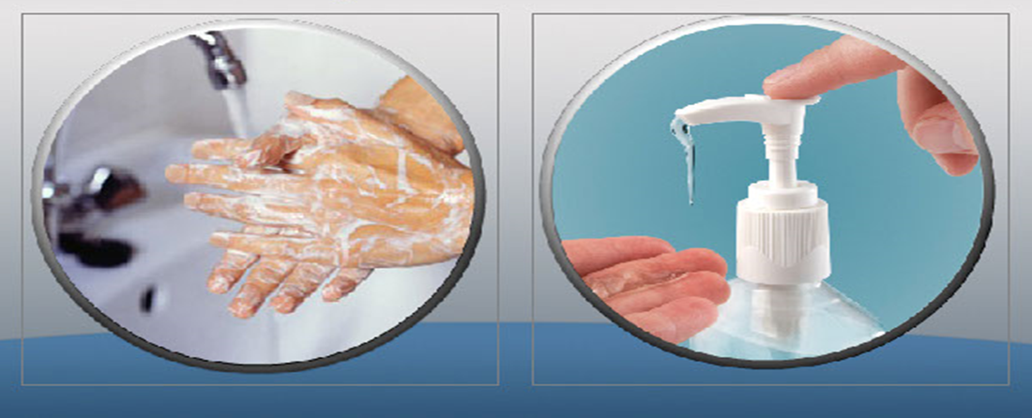
What is Hand Hygiene?
Hand Hygiene includes cleaning hands with soap and water or alcohol-based hand rub in order to remove germs, also known as microorganisms.

Slide 4
Who should practice Hand Hygiene?
Hand hygiene is important not only for healthcare providers; everyone needs to be practicing appropriate and effective hand hygiene regardless of work setting.

Slide 5
Where should you perform Hand Hygiene?
Busy health care providers need access to hand hygiene products where patient or patient environment contact is taking place.
Hand hygiene is important in all work settings, including Acute Care, Long Term Care Facilities, Community and Corporate sites.
Providing alcohol-based hand rub at the point of care (within arm’s reach) is an important system support to improve hand hygiene.
This enables health care providers to quickly and easily fulfill the 4 Moments for Hand Hygiene.

Slide 6
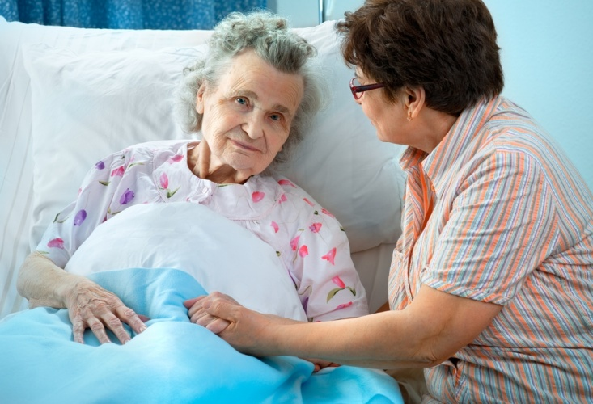
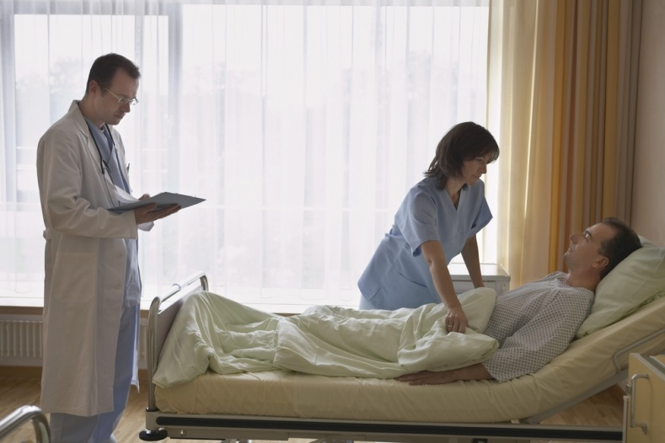
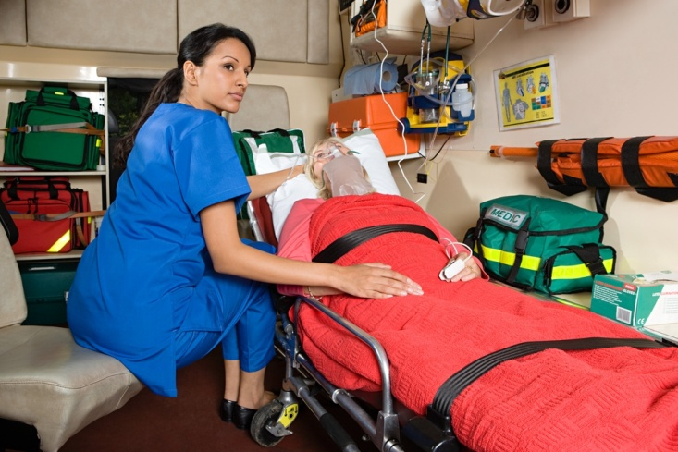
Points of Care
The patient
The Health Care provider
Care involving contact

Slide 7
Why do we need to learn about Hand Hygiene?
Hand hygiene is the most important way to prevent the spread of germs.
Hand hygiene helps keep you healthy by reducing the number of germs on your hands and helps reduce the spread of germs to your family, friends, coworkers, patients, residents or clients.
Using appropriate hand hygiene prevents contamination of the patient’s, client’s, or resident’s environment.

Slide 8
When do you perform Hand Hygiene
There are 4 moments when hand hygiene is performed.
Before initial patient or patient environment contact
Before aseptic or clean procedure
After body fluid exposure risk
After patient or patient environment contact
Remember...hand hygiene prevents carrying germs into and out of the patient’s environment.

Slide 9
Moment 1. Before contact with a patient or patient environment
Before shaking hands
Before transferring
Clean your hands when entering or before touching the patient.

Slide 10
Moment 1. Before contact with a patient or patient environment
Before taking temperature, blood pressure or pulse
Before making someone comfortable in bed
This will protect the patient from harmful organisms carried on your hands.

Slide 11
Moment 1. Before contact with patient or patient environment
Before contact with…
Patient’s room
Equipment
Wheel chair or stretcher
Clean your hands when entering or before touching any object or furniture in the patient’s environment.

Slide 12
Moment 1. Before contact with patient or patient environment
Before contact with…
Home environment
Treatment area or clinic room
This is to protect the patient environment from harmful organisms carried on your hands.

Slide 13
Moment 2. Before aseptic/clean procedure
Clean your hands before…
Handling dressings or touching open wounds
Performing invasive procedures
This prevents the patient’s own organisms from entering his or her body.
Clean your hands immediately before any aseptic or clean procedure to protect the patient against harmful organisms.

Slide 14
Moment 3. After body fluid exposure
Clean your hands after…
Contact with blood, bodily fluids, non-intact skin or mucous membranes,
Removal of gloves
Contact with contaminated items
Clean your hands immediately after an exposure risk to body fluids (and after glove removal).

Slide 15
Moment 3. After body fluid exposure
Clean your hands after…
Performing invasive procedures
Using a tissue to wipe your nose or toilet use
This can help protect yourself and the health care environment from harmful patient organisms.

Slide 16
Moment 4. After contact with a patient
Clean your hands after…
Shaking hands
Transferring
Making someone comfortable in bed
Help protect yourself and the health care environment from harmful patient organisms.
Clean your hands when leaving the environment after touching patient.

Slide 17
Moment 4. After contact with the patient environment
Clean your hands after…
Contact with room
Contact with equipment
Contact with wheelchair or stretcher
Clean your hands when leaving after touching any object or furniture in the patient’s environment

Slide 18
Moment 4. After contact with the patient environment
Clean your hands after…
Contact with home environment
Contact with treatment area or clinic room
Help protect yourself and the health care environment from harmful patient organisms.

Slide 19
Let’s Review
The 4 Moments of Hand Hygiene are:
1. Before initial patient or patient environment contact
2. Before aseptic or clean procedures
3. After body fluid exposure
4. After contact with patient or patient environment

Slide 20
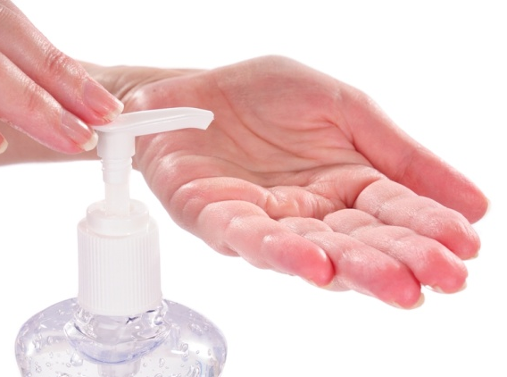
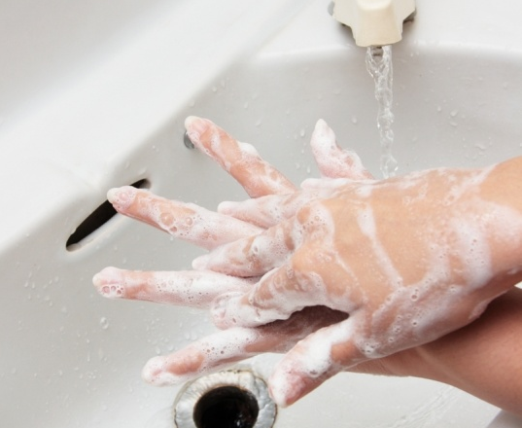
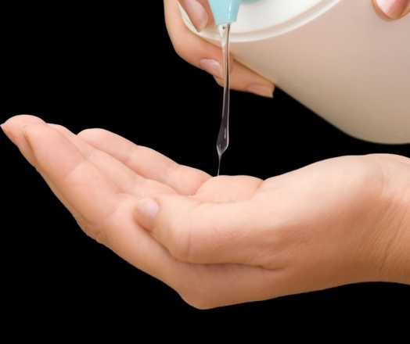
How to perform hand hygiene
Proper technique is important when it comes to effective hand hygiene. Without proper hand hygiene technique, we can still spread many microorganisms with our hands. This section will cover the proper techniques for the following methods:
Alcohol-based hand rub
Soap and water
Without water when hands are soiled

Slide 21
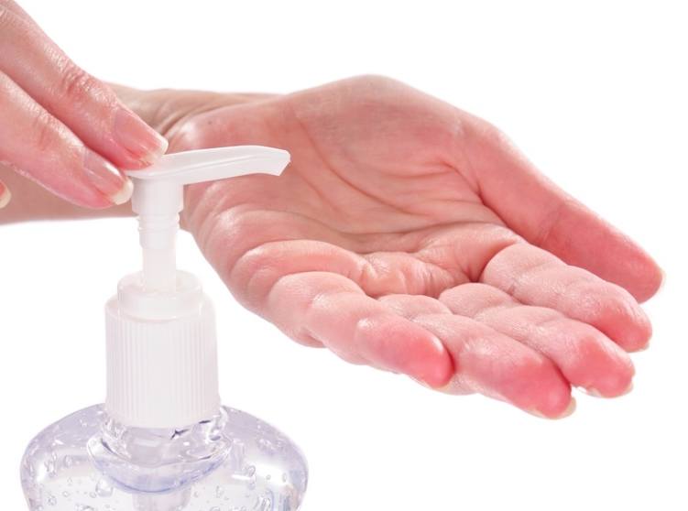
Alcohol-based hand rub
Alcohol-based hand rub is the recommended method of hand hygiene in any healthcare setting when hands are not visibly soiled.
Click link below for video on how to properly wash with soap and water.
http://www.wrha.mb.ca/extranet/ipc/hand-hygiene-videos.php

Slide 22
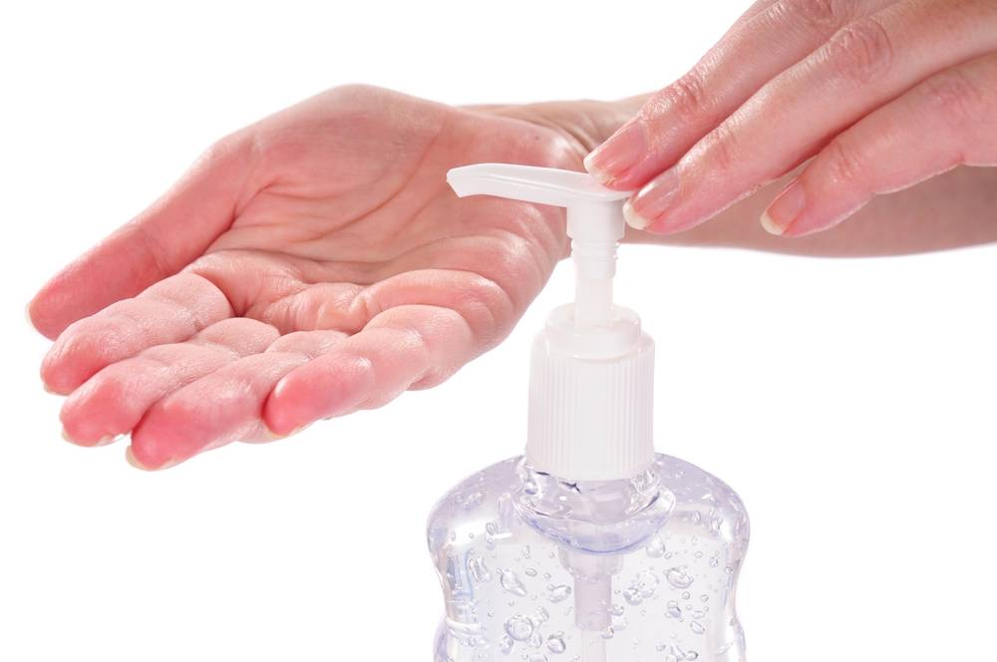
Alcohol-based hand rub
Apply a dime-sized amount (2-3 ml) of product into palms of dry hands
Rub product into hands
Palm to palm
Rub fingertips of each hand in opposite palm
Between and around fingers
Rub each thumb clasped in opposite hand
Rub back of each hand with opposite palm
Rub hands until dry before performing another task
DO NOT WIPE OFF

Slide 23
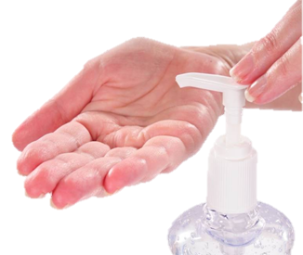
Alcohol-based hand rub
Alcohol based hand rub (ABHR) is at least 60% ethyl alcohol, or ethanol (equal to 120-proof). To compare, a bottle of vodka is 80-proof
Ingesting small amounts of ABHR can produce the same side effects as consuming large amounts of alcohol:
Headache, dizziness, drowsiness, incoordination, nausea, slowed reaction time, slurred speech, giddiness, and unconsciousness
Consumption of ABHR can also result in:
Brain, liver, and kidney damage (from long-term use)
Toxic ethanol levels

Slide 24
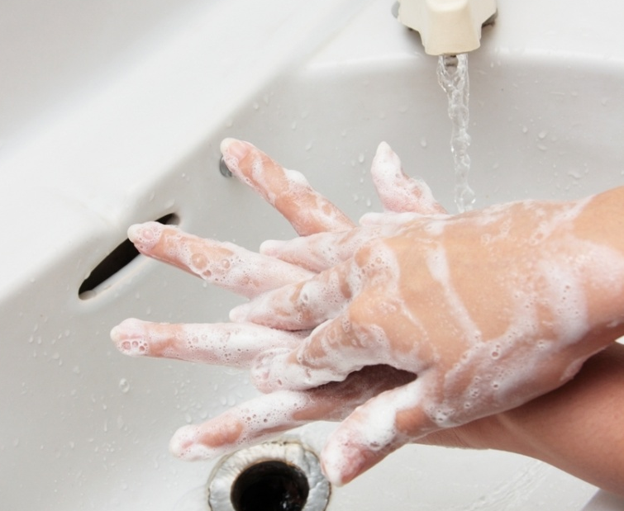
Soap and Water
Soap and water is the recommended method when hands are visibly soiled. Plain soap is used for routine hand hygiene while anti-microbial soap is used in acute care high-risk areas.
Click link below for video on how to properly wash with soap and water.
http://www.wrha.mb.ca/extranet/ipc/hand-hygiene-videos.php

Slide 25
Soap and Water
Wet hands under warm running water
Apply soap and distribute over hands
Rub hands together vigorously for 15 seconds to create a good lather: Palm to palm
Rub fingertips of each hand in opposite palm
Between and around fingers
Rub each thumb clasped in opposite hand
Rub back of each hand with opposite palm
Rinse hands thoroughly under warm running water
Pat hands dry with a paper towel
Turn off faucet using a paper towel

Slide 26
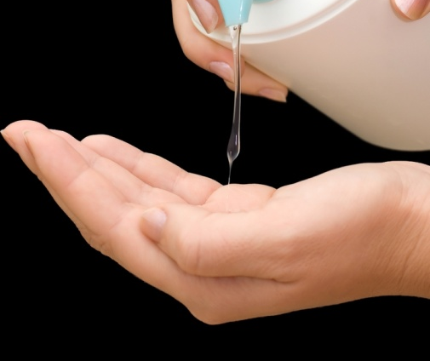
Hands are soiled and no water
On occasion, you may find yourself with soiled hands and no access to running water. When access to hand washing facilities is limited and running water is unavailable, use a moist towelette to remove visible soiling from hands followed by alcohol-based hand rub.
Click link below for video on how to properly wash with soap and water.
http://www.wrha.mb.ca/extranet/ipc/hand-hygiene-videos.php
Moist towelette
Followed by hand-rub

Slide 27
Hands are soiled and no water
Remove visible soiling with moist towelette
Apply a dime-sized amount of hand-rub product into palms of dry hands
Rub product into hands: Palm to palm
Rub fingertips of each hand in opposite palm
Between and around fingers
Rub each thumb clasped in opposite hand
Rub back of each hand with opposite palm
Rub hands until dry before performing another task
DO NOT WIPE OFF

Slide 28
“Handy” Tips
1 Artificial nails, gel nails or extenders are not to be worn by staff who have direct patient contact.
2 Contaminated surfaces or objects should not be touched after performing hand hygiene.
3 Avoid touching your face, especially your eyes and nose.
4 Fingernails should be kept short - no longer than ¼” or 0.635cm long.
5 Nail polish may be worn, but should be removed when chipped.

Slide 29
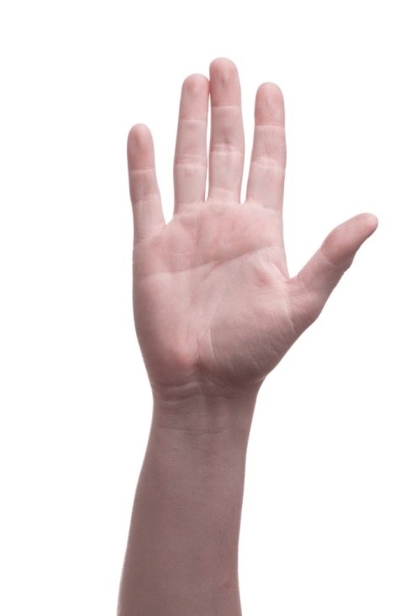
“Handy” Tips
6 Do not “top up” a partially-used hand hygiene product dispenser.
7 If re-usable dispensers are used they must be emptied, washed and dried prior to being refilled. Hand lotion bottles must not be re-used.
8 Include frequently missed areas when performing hand hygiene such as thumbs, palms, web spaces, under nails and the backs of fingers and hands.
9 Use supplied lotions that are compatible with hand hygiene products and gloves to minimize skin irritation that can occur with frequent hand hygiene.
10 Wearing hand and wrist jewelry is not recommended.

Slide 30
Remember 4M
1. Before initial patient or patient environment contact
2. Before aseptic or clean procedures
3. After body fluid exposure
4. After contact with patient or patient environment

Slide 31
Thank You

