Slide 1
Applying Bandages

Slide 2
Bandages
Bandages are used to :
• Fix the dressings and splinters
• Apply pressure over the wounds or to blood vessels
• Support injured parts ( eg: slings , binders)
• Limit swelling
• Restrict movements

Slide 3
Types of bandages
Triangular bandage –
• Usually made by cloth.
• Used as slings
• Secure dressing
• Immobilize injured limbs

Slide 4
Roller bandages –
Secure dressing
• Give support to limbs

Slide 5
Tubular bandages –
• Secure dressings
• Give support to limbs

Slide 6
Turns use in;
Simple spiral
Revers spiral
Figure of eight
Spica

Slide 7
General Rules
• Use only tightly and evenly rolled bandages
• Never unroll more than 3 -4 inches of a bandage at a time
• Apply outer side of the tail of bandage to the part
• Bandage limbs from below to upward and outer to inward
• Bandage the chest from below to upward
• Bandage the abdomen from above to downwards

Slide 8
• Apply a bandage which each layer covers two thirds of the previous one. Keep the edges parallel.
• Position your self in front of the injury
• When start bandaging, make two strait turns to anchor the bandage
• Make spiral turns with the bandage from inner side to outwards

Slide 9
Dressings
A dressing is a sterile covering for a wound
All open wounds should be covered to
Prevent infection
Control bleeding
Prevent further injury
Large or deep wounds should always be cleaned and treated at a medical facility; don’t try to clean them yourself.
Note: A dressing is a sterile wound covering; a bandage holds a dressing in place.

Slide 10
Dressings
Dressings should be
Sterile (microorganism- and spore-free)
Aseptic (bacteria-free)
Held in place with a bandage firmly enough to control bleeding, but not stop circulation (i.e., not too tight)
Larger than the wound
Soft, thick, and compressible
Most are porous, allowing air to circulate
Ideally, layered, lint-free, gauzy, and somewhat bulky
Always placed against the wound and held by bandage; the bandage should never directly touch the wound

Slide 11
Types of Commercial Dressings
Occlusive: have an airtight and waterproof seal; used for specific types of chest wounds
Compress: thick, bulky, usually sterile, intended to stop bleeding
Trauma: larger area, thick, sterile, absorbent; used for more serious or widespread injury
Adhesive strips: combination sterile dressing and bandage, individually packaged; used for small wounds
Adhesive tape: commonly unsterile, comes in varying-width rolls, not applied directly to wounds; holds dressings in place

Slide 12
Types of Commercial Dressings
Gauze pads: used in various dressings, may have coating to prevent sticking; the portion applied to a wound should be sterile
Special pads: commonly used for larger-area trauma; also called multitrauma pads
Bandage compresses: special dressing used to cover wounds and help control heavy bleeding

Slide 13
Bandages
The most common type is an adhesive strip (Band-Aid)
Bandages must
Hold a dressing in place over a wound.
Create pressure that controls bleeding.
Help keep the edges of a wound closed.
Secure a splint to an injured body part.
Provide support for an injured body part.
Help prevent or reduce swelling.

Slide 14
Bandages
The most common mistakes are applying bandages too tightly or too loosely
Signs that a bandage is too tight
Nearby skin becomes pale or a bluish color
Nearby fingernails/toenails develop a bluish tinge
Skin beyond the bandage is cold, tingling, or numb
If you press on the nail bed and let go, it does not quickly turn pink again
The victim cannot move their fingers or toes

Slide 15
Types of Bandages
Triangular
Unbleached cotton, cut in triangle shape
Easy to apply
Can be used on most parts of the body
Cravat
A folded triangular bandage
Roller
Made from gauze-like material
Comes in different widths, making it flexible
Most popular is self-adhering (nonelastic) and form-fitting

Slide 16
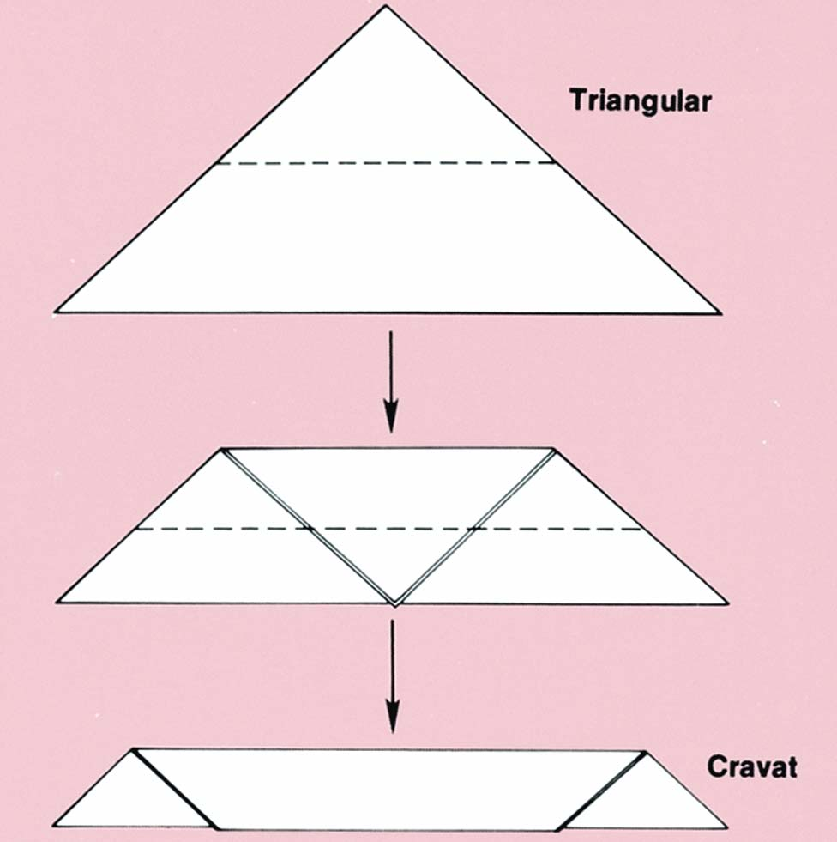
Triangular and Cravat Bandages

Slide 17
Dressing and Bandaging Principles
Handle carefully to prevent contamination.
Don’t apply bandages until bleeding has stopped.
Don’t remove original dressing if blood soaks through.
Ensure that the dressing completely covers the wound.
Do not place bandages directly on wounds (only sterile dressings).
Bandage wounds snugly but not tightly.

Slide 18
Dressing and Bandaging Principles
Bandages should not be loose; dressing and bandage should not slip or shift.
Ensure that there are no loose ends that could catch on things.
Cover all edges of the dressing with the bandage.
Leave tips of fingers and toes exposed when bandaging arms and legs.
Bandage a body part in the position it should remain.
Never use a circular bandage around a victim’s neck.

Slide 19
Improvising Dressings and Bandages
Some situations require improvisation.
No hard-and-fast rules; use adaptability and creativity.
Use materials on hand and methods you can best adapt.
Use materials that are as clean as possible.
Never touch the wound directly.
Control bleeding.

Slide 20
Improvising
In an emergency can use if clean
Handkerchief
Washcloth or towel
Sheet or pillowcase
Sanitary napkin
Plastic wrap can be used as part of an occlusive dressing
Never use
Elastic bandages
Fluffy cotton or cotton balls
Paper towels, toilet tissue, or other materials cling when wet

Slide 21
Special Dressing and Bandages
Pressure dressings
Apply snugly enough to create pressure on wound.
Slings
Used to support injuries of shoulder, arm, or rib.
If available, use a triangular bandage.

Slide 22
Summary
A dressing is a sterile cover for a wound.
The ideal dressing is sterile, gauzy, and layered.
Never use materials that could cling to, shred on, or disintegrate over a wound as a dressing.
A bandage holds a dressing in place and does not touch the wound.
Bandages should not be too tight or too loose.

Slide 23
Thank You

