Slide 1
Instilling Medication into Ear

Slide 2
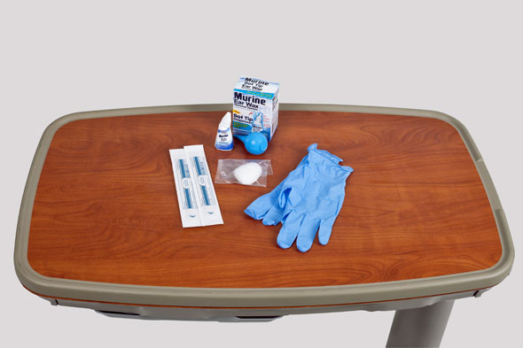
Administering Ear Medication

Slide 3
Safety
Ensure that the Six Rights of Medication Administration are followed: right medication, right dose, right patient, right route, right time, and right documentation.
Administer ear drops at room temperature. Instilling cold drops can cause vertigo (severe dizziness) or nausea and debilitate a patient for several minutes.

Slide 4
Although structures of the outer ear are not sterile, use sterile drops and solutions in case the eardrum is ruptured.
Avoid forcing solution into the ear.
Do not occlude the ear canal with a medicine dropper; doing so can cause pressure within the canal during instillation and subsequent injury to the eardrum.

Slide 5
Equipment List for Administering Ear Medication
Prescribed medication
Clean gloves
Cotton-tipped applicator and cotton balls

Slide 6
Preparation
Check the accuracy and completeness of each medication administration record (MAR) against the health care provider’s medication order.
Confirm the patient’s name, the drug and dosage, number of drops to instill, ear to be treated (left, right or both), and the time of administration.
Clarify incomplete or unclear orders with the health care provider
Note patient allergies.

Slide 7
Read manufacturer’s application/administration directions carefully.
Observe the six rights of medication administration: right medication, right dose, right patient, right route, right time, and right documentation.
Prepare medications for application. Check label of medication against MAR two times. Check expiration date on container.
If ear medication has been refrigerated, hold container in hands for a few minutes to bring to body temperature.

Slide 8
Procedure Guidelines for Administering Ear Medications
1. Verify the health care provider’s orders.
2. Gather the necessary equipment and supplies.
3. Perform hand hygiene.
4. Provide for the patient’s privacy.
5. Introduce yourself to the patient and family, if present.

Slide 9
6. Identify the patient using two identifiers. Ask the patient about allergies.
7. Take the medication to the patient at the correct time (refer to agency policy).
Give time critical medications (e.g., stat and “now” doses) at the exact time ordered.
As you proceed, apply the Six Rights of medication administration.

Slide 10
8. Discuss the purpose of each medication, its action, and possible adverse effects. Allow the patient to ask questions about the drugs.
Patients who wish to self-instill medications may be allowed to do so under a nurse’s supervision (check agency policy).
9. Instill ear medication:
` A. Apply clean gloves if drainage is present.

Slide 11
B. Position the patient on his or her side (if not contraindicated) with the ear to be treated facing up.
Alternately the patient may sit in a chair or at the bedside.
Tilt the patient’s head toward the unaffected side, and stabilize it with the patient’s own hand.
C. For an adult or child older than 3 years of age, straighten the ear canal by pulling the pinna up and back to the 10 o’clock position.
For a child younger than 3 years of age, pull the pinna down and back to the 6 o’clock or 9 o’clock position.

Slide 12
D. If cerumen or drainage occludes the outermost portion of the ear canal, wipe it out gently with a cotton-tipped applicator. Take care not to force cerumen into the canal.
E. Instill the prescribed drops by holding the dropper 1 cm (½ inch) above the ear canal.

Slide 13
F. Ask the patient to remain in a side-lying position, on the unaffected side, for a few minutes.
Gently massage or put pressure on the tragus of the ear with your finger.
G. If ordered, gently insert a portion of a cotton ball into the outermost part of the ear canal.
Do not press cotton into the canal. Remove the cotton after 15 minutes.

Slide 14
10. Dispose of your used supplies in the appropriate trash receptacle, remove and dispose of your gloves (if used), and perform hand hygiene.
11. After the drops have been absorbed, help the patient into a comfortable position and place toiletries and personal items within reach.
12. Place the call light within easy reach, and make sure the patient knows how to use it to summon assistance.

Slide 15
13. To ensure the patient’s safety, raise the appropriate number of side rails and lower the bed to the lowest position.
14. Leave the patient’s room tidy.
15. Document and report the patient’s response and expected or unexpected outcomes.

Slide 16
Thank You

