Slide 1
Shaving a Client (Male)

Slide 2
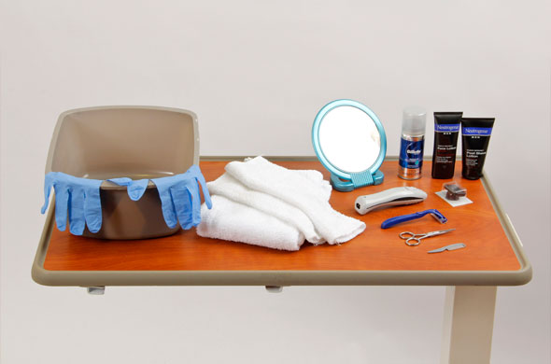
Shaving a male patient

Slide 3
Equipment for Shaving a Male Patient
Shaving with razor:
Disposable razor
Clean gloves
Bath towels
Hand mirror
Washcloth
Washbasin
Shaving cream
Aftershave lotion
Shaving with electric razor:
Electric razor
Bath towel
Skin or beard conditioner
Hand mirror
Aftershave lotion
Moustache care:
Scissors( small manicure or moustache scissors)

Slide 4
Procedural Guidelines for Shaving a Male Patient
1. Verify the health care provider’s orders.
2. Gather the necessary equipment and supplies.
3. Perform hand hygiene.
4. Provide for the patient’s privacy.
5. Introduce yourself to the patient and family if present.
6. Identify the patient using two identifiers, such as name and date of birth or name and account number, according to agency policy. Compare these identifiers with the information on the patient’s identification bracelet.

Slide 5
7. Before shaving a patient with a disposable razor, review medical history and lab values to assess bleeding risk.
8. Look at patient’s facial hair and skin to assess for any broken skin or reddened areas.
9. Raise the bed to a comfortable working height and lower the side rail.
10. Shaving with a disposable razor:
A. Apply clean gloves.
B. Test the water to ensure that it is not too hot.
C. Place a washcloth in the basin.

Slide 6
D. Place a bath towel over the patient’s chest and shoulders.
E. Wring out the washcloth thoroughly. Apply the warm, moist washcloth over the patient’s facial hair for several seconds.
F. Apply approximately ¼-inch layer of shaving cream or soap to the patient’s face. Smooth the cream evenly over the sides of the patient’s face, over his chin, and under his nose.
G. Hold the razor in your dominant hand at a 45-degree angle to the patient’s skin. Use your nondominant hand to gently pull the skin taut while shaving.
H. Begin by shaving across one side of the patient’s face, using short, firm strokes in the direction in which the hair grows.

Slide 7
I. Check with the patient, and ask him if he feels comfortable.
J. Dip the razor in the water as shaving cream accumulates on the blade.
K. After the patient has been shaved, change the water in the basin and rinse his face thoroughly with another warm, moist washcloth.
L. Dry the face thoroughly, and apply aftershave lotion if the patient wishes.
M. Help the patient into a comfortable position.
N. Return the used equipment to its proper place. Discard soiled linen in the linen bag, and perform hand hygiene.

Slide 8
11. Shaving with an electric razor:
A. Apply clean gloves if necessary.
B. Place a bath towel over the patient’s chest and shoulders.
C. Apply a skin conditioner or pre-shave preparation to the patient’s face.
D. Turn the razor on, and begin by shaving across the side of the patient’s face. Gently hold the patient’s skin taut while shaving over the skin’s surface. Use a gentle downward stroke of the razor in the direction of the hair growth.
E. When you finish, apply an aftershave lotion if the patient wishes, unless it is contraindicated.

Slide 9
F. Help the patient into a comfortable position.
G. Return the used equipment to its proper place. Discard soiled linen in the linen bag, remove gloves, and perform hand hygiene.
12. Providing moustache and beard care:
A. Place a bath towel over the patient’s chest and shoulders.
B. If necessary, gently comb the patient’s moustache or beard.
C. Allow the patient to use a mirror and direct you to the beard or moustache areas to trim with scissors. Use your dominant hand to hold a pair of small scissors as you groom those areas.

Slide 10
D. Inspect the condition of the patient’s shaved face. Inspect the skin beneath the beard or moustache. Ask patient if patient feels clean and if he is comfortable.
13. Help the patient into a comfortable position, and place toiletries and personal items within reach.
14. Place the call light within easy reach, and make sure the patient knows how to use it to summon assistance.
15. To ensure the patient’s safety, raise the appropriate number of side rails and lower the bed to the lowest position.

Slide 11
16. Dispose of used supplies and equipment. Leave the patient’s room tidy.
17. Remove and dispose of gloves, if used. Perform hand hygiene.
18. Document and report the patient’s response (i.e., tolerated or not), and expected or unexpected outcomes, such as bleeding, pain, or problem skin areas.

Slide 12
Thank You

