Slide 1
Administering Nasal Drops and Sprays

Slide 2
Instilling Nasal Medications
Nasal medications are instilled for the treatment of allergies, nasal congestion, and sinus infections.
The nose is not a sterile cavity, but medical asepsis must be observed because of its connection to the sinuses.

Slide 3
Safety considerations
Perform hand hygiene.
Check room for additional precautions.
Introduce yourself to patient.
Confirm patient ID using two patient identifiers (e.g., name and date of birth).
Check allergy band for any allergies.
Complete necessary focused assessments and/or vital signs, and document on MAR.
Provide patient education as necessary.

Slide 4
Plan medication administration to avoid disruption:
Dispense medication in a quiet area.
Avoid conversation with others.
Follow agency’s no-interruption zone policy.
Prepare medications for ONE patient at a time.
Follow the SEVEN RIGHTS of medication administration.

Slide 5
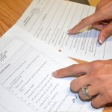
Steps
STEPS | ADDITIONAL INFORMATION
1. Check MAR against doctor’s orders. | Check that MAR and doctor’s orders are consistent. Compare physician orders and MAR Night staff usually complete and verify this check as well.

Slide 6
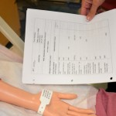
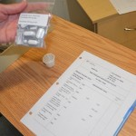
2. Perform the SEVEN RIGHTS x 3 (must be done with each individual medication): The right patient The right medication (drug) The right dose The right route The right time The right reason The right documentation Medication calculation: D/H x S = A (D or desired dosage/H or have available x S or stock = A or amount prepared) | Check the right patient, medication, dose, route, time, reason, documentation NEVER document that you have given a medication until you have actually administered it.

Slide 7
3. The label on the medication must be checked for name, dose, and route, and compared with the MAR at three different times: When the medication is taken out of the drawer When the medication is being poured When the medication is being put away/or at bedside | Perform seven checks three times before administering medication These checks are done before administering the medication to your patient. If taking drug to bedside (e.g., eye drops), do third check at bedside.

Slide 8
4. Before instilling nasal medication, don clean non-sterile gloves. | Using gloves protects the nurse from potential contact with patient body fluids and medications. Apply non-sterile gloves

Slide 9
5. Provide patient with tissues and ask that they blow their nose. | This clears the nose prior to medication instillation.
6. Position patient sitting back or lying down with head tilted back over a pillow (underneath neck). | This position allows medication to flow back into nasal cavity. Do not tilt head back if patient has a cervical spine injury.
7. Nose drops: draw fluid into medication dropper with enough for both nares. Do not return excess fluid into stock bottle. | Returning fluid to stock bottle increases risk for contamination of medication.

Slide 10
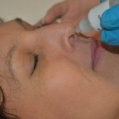
8. Ask patient to breathe through the mouth. Nose drops: hold dropper about 1 cm above naris and drop medication into one naris and then the other. Nasal spray: have patient hold one nostril closed and breathe gently through the other as the spray is being administered. Do not touch the naris with the dropper/spray bottle. | Hold dropper about 1 cm above narisBreathing through the mouth will help prevent aspiration of the medication. Touching the naris with the dropper/spray tip will contaminate the dropper/spray bottle and the medication.
9. Position patient with head back for 2 to 3 minutes. | This position prevents escape of the medication.
10. Remove gloves and assist patient to a comfortable and safe position. | This ensures patient safety and comfort.

Slide 11
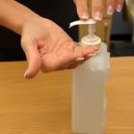
11. Perform hand hygiene. | Hand hygiene prevents the spread of microorganisms. Hand hygiene with ABHR
12. Document as per agency policy. Include date, time, dose, route; which naris the medication was instilled into (or whether it was both nares); and patient’s response to procedure. | Timely and accurate documentation helps to ensure patient safety.

Slide 12
Thank You

