Slide 1
Performing a Hair Wash

Slide 2
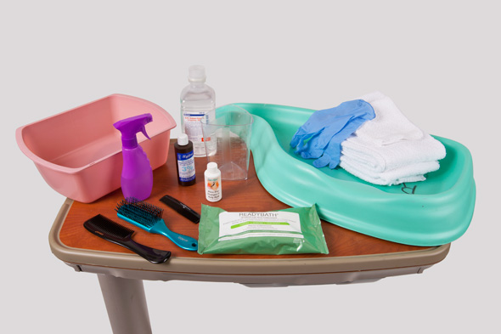
Performing a hair wash

Slide 3
Equipment List for Performing Hair Care and Shampooing in Bed
Comb and hairbrush
Spray bottle
Shampoo and conditioner
Hydrogen peroxide (optional)
Saline solution (optional)
Water pitcher or Graduated measuring cylinder
Plastic shampoo board
Washbasin
Towels and washcloths
Waterproof pad
Clean gloves
Disposable shampoo cap product (optional)

Slide 4
Procedure Guideline for Performing Hair Care and Shampooing in Bed
1. Combing and brushing hair:
A. Provide for the patient’s privacy.
B. Perform hand hygiene.
C. Arrange the supplies on the bedside table, and adjust the lighting.
D. Determine if there are any contraindications to the procedure.
E. Ask the patient if they like any specific hair care products, or if they have a styling preference.
F. Encourage the patient to inform you if they are uncomfortable at any time.

Slide 5
G. Apply clean gloves.
H. Place a towel over the patient’s shoulders or under his or her head if the patient is in bed.
I. Using a comb, part the hair into two sections, and then separate the hair into two more sections.
J. Inspect the condition of the patient’s hair and scalp
K. Moisten the hair lightly with water, conditioner, or an alcohol-free detangling product before combing it.
L. Move your fingers through the hair to loosen any larger tangles.
M. Using a wide-tooth comb, begin on either side of the head and comb from the scalp toward the ends of the hair. Continue until all hair has been combed through, and then comb it into place to shape and style it.

Slide 6
2. Shampooing a bed bound patient:
A. Explain the procedure, and provide privacy.
B. Before washing the patient’s hair, determine that there are no contraindications to the procedure. Verify the physician’s order, if required.
C. Identify the patient using two identifiers, such as the patient’s name and birth date or the patient’s name and account number, according to agency policy.
D. Gather needed supplies.
E. Carefully position the patient into a supine position with head and shoulders at the top edge of the bed.

Slide 7
F. Perform hand hygiene, and apply clean gloves.
G. Inspect the hair and scalp before beginning the shampoo. Inspect the hair and scalp for abrasions, lacerations, inflammation and infestation. Determine if special shampoos or treatments, such as those for dandruff, lice, or removal of blood, are necessary. If lice are present, wear a disposable gown in addition to gloves.
H. When shampooing the hair while using a shampoo board:
(1) Place a waterproof pad under the patient’s shoulders, neck, and head. Place the shampoo board under the patient’s head and a washbasin under the end of the trough spout. Be sure that the spout extends beyond the edge of the mattress.
(2) Place a rolled towel under the patient’s neck and a towel over the patient’s shoulders.

Slide 8
(3) Brush and comb the patient’s hair to remove any tangles
(4) Obtain a pitcher filled with warm water.
(5) Place a towel or washcloth over the patient’s eyes. Ask the patient to hold a towel or washcloth over his or her eyes if they wish to do so.
(6) Slowly pour the water from the pitcher over the patient’s hair until it is completely wet. If the hair contains matted blood, apply hydrogen peroxide to the hair to dissolve the clots, being careful when near open wounds, and then rinse the hair and any scalp areas affected with saline. Apply a small amount of shampoo.
(7) Work up a lather using both of your hands. Begin at the hairline, and work toward the nape of the neck. Then shampoo the sides of the head. Massage the scalp by applying pressure with your fingertips. Lift the patient’s head slightly with one hand to wash the back of the head.
(8) Rinse the hair with water. Make sure that the water drains into the basin. Continue rinsing the hair until it is free of all soap.
(9) Wrap the patient’s head in a towel. Dry the patient’s face with the cloth he or she used earlier to protect the eyes. Dry off any moisture along the patient’s neck or shoulders.

Slide 9
(10) Dry the patient’s hair and scalp. Use a second towel if the first one becomes saturated.
(11) Comb the patient’s hair to remove any tangles.
(12) Apply an oil preparation or conditioning product to the hair, if desired by the patient.
(13) Variation for patients with coarse, curly hair: Condition the hair after washing. To untangle the hair, use the wide toothed comb. Begin at the nape of the neck and comb small subsections of the hair, starting at the hair ends. Continue to work through small sections of the hair until the hair is free of tangles.
(14) Assist the patient into a comfortable position, and finish styling the patient’s hair.
(15) Dispose of and store supplies used during the procedure. Remove your gloves, and perform hand hygiene.
(16) Document shampooing if required by the agency.

Slide 10
Shampooing using a disposable shampoo cap product:
(1) Perform hand hygiene
(2) Help the patient into a comfortable position. The patient can be sitting on a chair or upright in the bed.
(3) Apply clean gloves.
(4) Comb the hair to remove any tangles or debris. Inspect scalp and hair.
(5) Pre-heat shampoo cap per manufacturer’s instructions. Open the package, apply the cap to the patient’s head, and secure all of the hair beneath the cap.

Slide 11
(6) Check the snugness of the cap around the patient’s head to maintain a correct fit. Massage the patient’s head through the cap for 2 to 4 minutes, according to package directions; additional time may be required for longer hair or hair that is matted with blood.
(7) Discard the cap in the trash; do not dispose of it in the toilet, because it may clog the plumbing
(8) If the patient desires, towel-dry the hair.
(9) Brush or comb the patient’s hair as patient prefers.
(10) Dispose of used towel.
(11) Remove your gloves and perform hand hygiene.

Slide 12
Thank You

