Slide 1
Bed Making - Unoccupied

Slide 2
DEFINITION OF TERMS
1.1 Bed making
the ability of the nurse to keep the bed clean and comfortable
the technique of preparing different types of bed in making patients/clients comfortable in his/her suitable position for a particular condition
it requires keen inspection to be sure that the linens are clean, dry and wrinkle-free
1.2 Fanfold
is done by grasping the upper edge of the linen with both hands
specifically folding the edge of the sheet used in the bed 6-8 inches outward
1.3 Mitered corner
a means of anchoring sheets on mattresses
method of folding the bed clothes at the corners to secure them in place while the bed is occupied
it is accomplished on the bottom sheet by placing the end of the sheet evenly under the mattress
1.4 Toe pleat
a fold made in the top bed clothes to provide additional space for patient’s toes

Slide 3
DEFINITION OF TERMS
1.5 Foot drop
dropping of the foot from paralysis of the anterior muscle of the leg
plantar flexion of the foot with permanent contracture of the gastrocnemius (calf) muscle and tendon
1.6 Bed cradle
is a curved, semi-circular device made of metal that can be placed over a portion of the patient’s body
is sometimes called an Anderson frame, is a device designed to keep the top bedclothes off the feet, legs, and even abdomen of a client
1.7 Magic corner
corners of a folded linen when upon opening it automatically positions the sheets the way it is placed on the bed

Slide 4
PURPOSE OF BEDMAKING
A. On changing an unoccupied bed
to promote the client's comfort
to provide a clean near environment for the client
to provide a smooth, wrinkle-free bed foundation, thus minimizing sources of skin irritation
B. On changing an occupied bed
to conserve the client's energy and maintain current healthy status
to promote the client's comfort
to provide a clean near environment for the client
to provide a smooth, wrinkle-free bed foundation, thus minimizing sources of skin irritation

Slide 5
IMPORTANCE OF BEDMAKING
It helps maintain a clean, orderly and comfortable room which contributes to the patients sense of well-being.
Helps the patient secure proper rest and comfort which are essential for health and refresh him/her by providing cleanliness
It helps prevent or avoid microorganisms to come in contact with the patient which could cause tribulations.
It minimizes the sources of skin irritation by providing smooth, wrinkle-free bed foundation.

Slide 6
TYPES OF BED
Bed
- is primarily divided into 3 sections
length: 1.9m (6.5ft).
weight: 0.9m (3ft.)
high: 66cm (26in.)
but sometimes varies depending on circumstances
A. Common Types of Bed
Occupied bed
the occupied bed is made when the patient is not able or not permitted to get out of the bed
the important part of making an occupied bed is to get the sheets smooth and tight under the patient so that there will be no wrinkles to rub against the patient’s skin
the client’s privacy, comfort and safety is also important when making the bed

Slide 7
TYPES OF BED
2. Unoccupied bed
the unoccupied bed is made when there is no patient confined in bed
A unoccupied bed may be:
A. Open bed
the top covers are generally folded back so that a client can easily get into bed
surgical, recovery and postoperative bed is a modified version of the open bed; the top bed line is arranged for easy transfer of the client from a stretcher to the bed
the top sheets are folded to one side or fanfolded to the bottom third of the bed
B. Close bed
the top sheet blankets and bedspreads are drawn up to the head of the mattress and under the pillows, this is prepared in a hospital room before a new client is admitted to that room

Slide 8
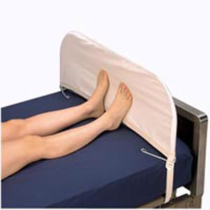
TYPES OF BED
C. Cradle Bed
Contains cradle, a device for holding the top covers off.
The outer cradle is made of wood, metal or at home for a brief period, a cardboard art to shape.

Slide 9
TYPES OF BED
D. Postoperative Bed
Also known as recovery bed or anesthetic bed.
Used not only for clients who have undergone surgical procedures but also for clients who have given anesthetics for a certain examination.
Used for a patient with a large cast or other circumstance that would make it difficult for him to transfer easily into bed.

Slide 10
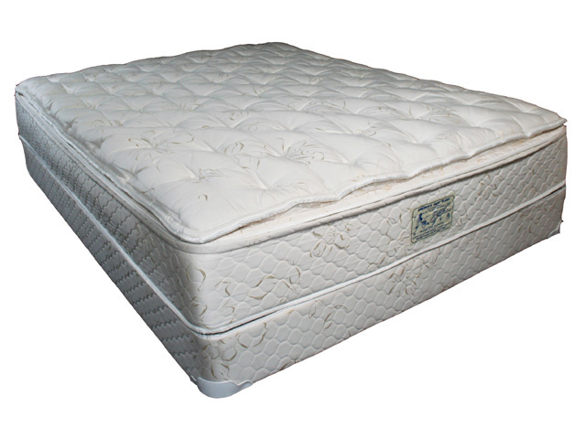
TYPES OF BED
B. Special Types of Beds
Water bed
Special mattress filled with water.
It controls temperature of water reducing pressure on body parts.
Indications:
Patients confined to bed for long periods

Slide 11
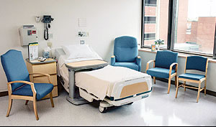
TYPES OF BED
2. Turning Frames (Stryker Wedge)
It allows repeated changes between the supine and prone positions without disturbing spinal alignment.
Indications:
complication of immobility such as atelectasis, pneumonia, decubitus ulcer and renal calculi.

Slide 12
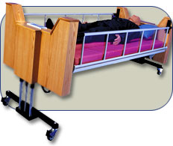
TYPES OF BED
3. Rotation Bed
promote postural drainage, peristalsis and helps prevent the complications of mobility
Indication:
patients with spinal cord injury, severe burns

Slide 13
TYPES OF BED
4. Circolectric Bed
Permits frequent turning of several injured or immobilized patient with minimal trauma or extraneous movement.
Helps prevent and treat pressure ulcers, respiratory and circulatory complications
Indications:
Patients confined to bed for long periods of time

Slide 14
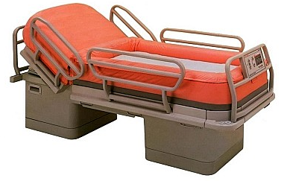
TYPES OF BED
5. Clinton Therapy Bed
Also called the air-fluidized bed
Designed for managing burns and patients with various disabilities.
Indications:
Patients with managing burns and patients with various disabilities.

Slide 15
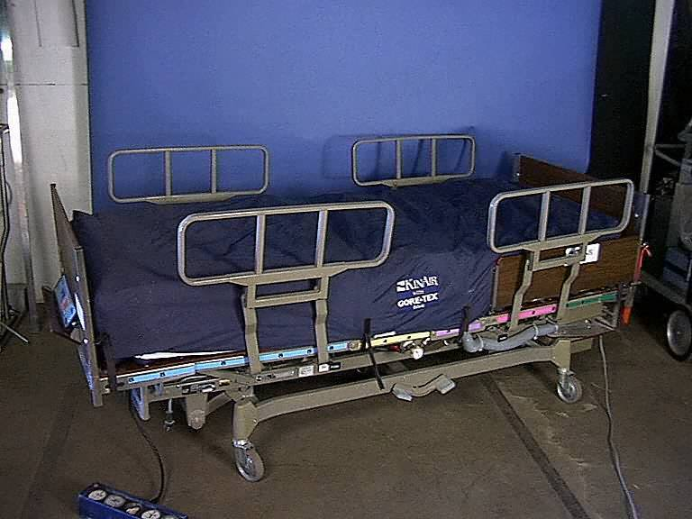
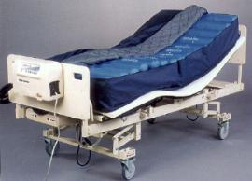
TYPES OF BED
6. Air Therapy Bed
For patients who have risk skin breakdown
Provide different levels of support to different body parts.
Indications
Patients who are at risk to skin breakdown

Slide 16
COMMON BED POSITIONS

Slide 18
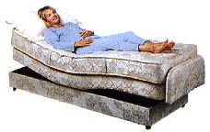
Contour
Head section is elevated; the knee and foot section are elevated.
Indications: used for certain injuries or disease of the lower extremities.

Slide 19
PRINCIPLES IN BEDMAKING
BODY MECHANICS
it is important to the nurse to observe the correct body mechanics in order to prevent quick tiring, back problems and muscle pain.
ANATOMY & PHYSIOLOGY
the conscious knowledge of the normal state and condition of certain parts of the body wherein one would be able to tell any abnormality.
the body exerts uneven points of pressure against different areas of the mattress. The sacrum may become the site for pre-assure sore because of the weight of the patient’s body and a reduced blood supply to the tissues over bony prominence.
CHEMISTRY
woolen blanket fibers may cause irritation to the patient’s skin; there must always be a sheet to separate the blanket from the patient
strong detergent, soap and bleaches used in commercial laundries may cause skin irritation if bed linens are not thoroughly rinsed

Slide 20
PRINCIPLES IN BEDMAKING
MICROBIOLOGY
pathogenic microorganism may be transferred from the source to a new host directly by contaminated linen. Hands should be washed before and after making bed.
bed linen should be folded away from the body to minimize the transfer microorganism to the clothing
fanning bed clothing stirs up bacteria in the air, and air motion is a method of transfer.
PHYSICS
friction can irritate the skin and cause rashes. It is therefore appropriate to keep the lines smooth and wrinkle-free.
stability of body (center of gravity over its base)
PSYCHOLOGY
use skill and efficiency in making the bed to minimize undue exertion and fatigue for the patient. If the procedure brings comfort and relaxation, his attitude will improve.
SOCIOLOGY
the nurse should know how to talk to patients. The nurse should also know the subject of conversation which interests the patient including his condition, family, and work.

Slide 21
KINDS OF LINENS
Blanket
a large piece of cloth often soft, woolen and is used for warmth as a bed cover
Top sheet
used to cover the patient to provide warmth, made of thick cotton, thermal material
Cotton drawn sheet
a piece of cloth that covers the rubber sheet and is used to absorb and protect moisture
Bottom sheet
used to cover the bed after mattress cover

Slide 22
KINDS OF LINENS
5. Rubber sheet
used to protect the bottom sheet from soothing due to patient secretions and prevent the patients from getting bedsore. It is usually placed over the center of the bottom sheet
6. Mattress cover
a piece of cloth to cover the mattress
7. Woolen blanket
a large rectangle piece of cloth of soft fabric often either bound edges used especially for warmth as a bed covering. It should be light, warm and large enough to cover the shoulder and to tuck in well at the foot and to extend over sides.

Slide 23
GUIDELINES IN BEDMAKING
Wash hands thoroughly after handling client’s bed linen.
Hold soiled linens away from the body.
Linen for one client is never placed on another client’s bed.
Soiled linen is placed directly in a portable linen hamper or tucked into a pillow case at the end of the bed before it is gathered up for disposal in the linen hamper or in linen chute. Pillowcase is then tied and labeled with: name, room number, communicable/non-communicable
Soiled linen is never shaken in air.
When stripping and making a bed, conserve time and energy by stripping and making up one side as completely as possible before working on the other side.
Gather all needed linen before starting to strip the bed.
Keep the patient’s environment as clean and as neat as possible.

Slide 24
BEGINNING SKILLS IN BEDMAKING

Slide 25
A. STRIPPING THE BED
Removal of used linen and the airing of the mattress.
Procedure:
Place chair at the foot of the bed.
Remove pillow case from pillow. Place pillow on chair. Place soiled pillow case on lower bar of the bed.
Loosen all bed linens starting at center of head of bed, raising the mattress with one hand and drawing out bed clothes with other.
Remove sheets separately. Fold each linen with soiled part inside. Wrap them all in a sheet and place on lower bar of the bed.
Roll rubber sheet and place on chair.
Remove mattress cover.

Slide 26
for an UNOCCUPIED BED - CLOSED BED
Arranging clean bed linens on patient’s bed ready for admission.
Equipment:
a. mattress cover
b. bottom sheet
c. rubber sheet
d. cotton draw sheet
e. top sheet
f. pillow cases - 2
g. blanket

Slide 27
Procedure:
Refold each sheet according to its system of use.
Place clean linens on chair in order of use. See to it that the bed is flat.
Cover mattress.
Place bottom sheet with center fold in center in line with rim of mattress at foot part. Spread across bed. Make mitered corner of head part. Tuck extra sheet at side from head to foot.
Put rubber sheet 12-15 inches from the head of mattress. Cover with drawsheet. Spread across bed. Tuck together extra length.
Place topsheet in line with mattress at head part and spread across bed. Tuck extra length of sheet at foot part. Miter corners. Allow to hang free at sides.
Go to opposite side and repeat same procedure.

Slide 28
Put pillow case on pillow. To put on, grasp middle of slip’s bottom. Flip open and grasp short side of pillow. Pull pillow slip over body of pillow.
Spread top sheet over pillow.
Pull folds of clean sheets into place. Tuck bottom sheet at head part and miter at the side.
Tighten rubber sheet and draw sheet. Tuck together with bottom sheet.
Help patient to roll on his back at center of bed.
Place clean fanfolded sheet over patient. Cover shoulders. Draw fanfolded sheet together with used top sheet at foot part.
Tuck clean top sheet at foot part. Miter corner.
Fit pillow into pillow case.
Fold dirty linens separately. Wrap in one sheet.
Carry soiled linens to laundry.

Slide 29
for an UNOCCUPIED BED - OPEN BED
Preparing the bed with new bed linens ready for newly admitted patients.
Procedure:
Refold each sheet according to its system of use.
Place clean linens on chair in order of use. See to it that the bed is flat.
Cover mattress.
Place bottom sheet with center fold in center in line with rim of mattress at foot part. Spread across bed. Make mitered corner of head part. Tuck extra sheet at side from head to foot.
Put rubber sheet 12-15 inches from the head of mattress. Cover with drawsheet. Spread across bed. Tuck together extra length.
Place topsheet in line with mattress at head part and spread across bed. Tuck extra length of sheet at foot part. Miter corners. Allow to hang free at sides.
Go to opposite side and repeat same procedure.
Grasp one corner of top sheet. Fanfold at foot part or diagonally to one side.

Slide 30
for an UNOCCUPIED BED POSTOPERATIVE BED
Arranging of bed linens to receive the patient who has just undergone surgery.
Equipment:
a. linen for occupied bed
b. emesis basin
c. cellu wipes
d. blanket
e. tongue blade
f. wash cloth
g. sphygmomanometer and stethoscope

Slide 31
Procedure:
Make foundation bed.
Place top sheet. Do not tuck.
Turn sheet back. Fanfold at sides.
Fanfold bedding across bed from side nearest the door.
Spread bath towel at head of bed.
Place folded blanket across bar at foot of bed.
Equip bedside table with emesis basin, cellu wipes, tongue blade, BP Apparatus and stethoscope

Slide 32
Safety
Follow infection control guidelines, because bed making increases the risk of exposure to—and transmission of—microorganisms. Be sure to wear clean gloves to remove soiled linen. Hold soiled linen away from your uniform, and avoid shaking or fanning it.
Use proper body mechanics when making a bed.
Assess the environment for safety; check the room for spills, make sure equipment is working properly, and ensure that the bed is in the locked, low position.
Remember to lower the side rails when preparing to make the bed.
Check the position of the chair for transfer.

Slide 33
Equipment List for Making an Unoccupied Bed
• Linen bag or hamper
• Mattress pad (optional, change only when soiled)
• Bottom sheet (flat or fitted)
• Top sheet
• Drawsheet (optional)
• Large, quilted waterproof pads
• Bath blanket
• Bedspread
• Pillowcases
• Bedside chair or table
• Clean gloves
• Washcloth
• Towel
• Antiseptic cleanser

Slide 34
Delegation
The skill of making an unoccupied bed can be delegated to nursing assistive personnel (NAP). Before delegating, be sure to inform the NAP of the following:
Any position or activity restrictions that affect the patient’s ability to get out of bed.
Any special linen instructions if the patient is on an airflow mattress.
Specify that Standard Precautions are to be used when making an unoccupied bed.

Slide 35
Preparation
Gather all needed equipment and supplies
Wear gloves when removing soiled linen.
Assess activity orders or restrictions on mobility or positioning, to ensure that the patient can get out of bed for the procedure.
Help the patient into a bedside chair, or plan to make the bed when the patient is out of the room.

Slide 36
Follow-up
Help the patient back to bed.
Ensure that the call light is within the patient’s reach on the bed rail or pillow.
Ask if the patient is comfortable.
Periodically check the linen for cleanliness and tightness.

Slide 37
Documentation
Do not document the making of an unoccupied bed.

Slide 38
Thank You

