Slide 1
Administering Oxygen via Nasal Cannula

Slide 2
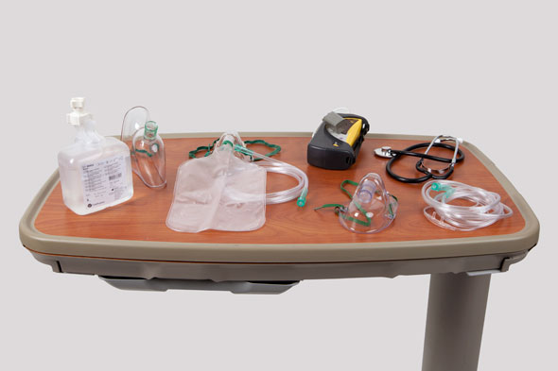
Applying a Nasal Cannula or Face Mask

Slide 3
Safety
Treat oxygen therapy as a medication.
Do not substitute oxygen for any other treatment.
Use it only when indicated, at the flow rate ordered.
Ensure that the patient has no contraindication to oxygen therapy, such as elevated PaCO₂ (hypercarbia), which puts the patient at increased risk for respiratory failure.

Slide 4
Do not interrupt oxygen therapy during patient transport.
A plastic face mask with a reservoir bag and a Venturi mask will deliver 60% to 90% oxygen at appropriate flow rates.
The reservoir bag of this oxygen mask maintains a high-concentration oxygen supply.
Frequently inspect the bag to make sure it is fully inflated.
If it is not fully inflated, the patient breathes in large amounts of exhaled carbon dioxide.

Slide 5
Equipment List for Applying a Nasal Cannula or Face Mask
Oxygen delivery device as ordered by health care provider
Oxygen tubing (consider extension tubing)
Humidifier, if indicated
Sterile water for humidifier
Oxygen source
Oxygen flowmeter
Appropriate room signs

Slide 6
Preparation
Assess the patient’s respiratory status, including the following:
Symmetry of chest wall expansion
Chest wall abnormalities, such as kyphosis
Temporary conditions that can affect ventilation, such as pregnancy or trauma
Respiratory rate and depth
Sputum production
Lung sounds
Signs and symptoms associated with hypoxia

Slide 7
Observe the patient for a patent airway, and remove airway secretions by having the patient cough and expectorate mucous, or by suctioning.
If available, note the patient’s most recent ABG results or SpO₂ value.
Review the patient’s medical record for the medical order for oxygen, noting the delivery method, flow rate, and duration of oxygen therapy.
Explain the procedure to the patient and family.

Slide 8
Procedure Guideline for Applying a Nasal Cannula or Face Mask
1. When a nasal cannula or face mask is prescribed for a patient, begin by checking the details of the health care provider’s orders.
Verify the oxygen delivery method, flow rate and duration of therapy.
2. Gather the necessary equipment and supplies.
3. Perform hand hygiene, and provide for the patient’s privacy.

Slide 9
4. Introduce yourself to the patient and family, if present.
5. Identify the patient using two identifiers, such as the patient’s name and birth date or name and medical record number, according to your agency’s policy.
Compare these identifiers in the patient’s MAR/medical record with the information on the patient’s identification bracelet.

Slide 10
6. Before administrating the oxygen, assess the patient’s respiratory system, including respiratory rate, sputum production and lung sounds.
Also check oxygen saturation and arterial blood gasses (ABG) if those values are available.
7. Attach the oxygen delivery device, such as a nasal cannula or mask, to the oxygen tubing, and attach the tubing to the oxygen source adjusted to the prescribed flow rate.

Slide 11
8. When an oxygen flow rate >4 L/min is ordered, apply a humidified oxygen source.
9. To position a nasal cannula, place the tips in the patient’s nares, and adjust the elastic headband or plastic slide on the cannula so that it fits comfortably and snugly.
10. Maintain sufficient slack on the oxygen tubing to keep it from pulling out as the patient moves. Secure the tubing to the patient’s clothing if necessary.

Slide 12
11. Observe for proper functioning of the oxygen delivery device:
A. Nasal cannula: Cannula is positioned properly in the nares.
B. Reservoir nasal cannula, such as the Oxymizer:
Fit this device the same as for a nasal cannula.
The reservoir is positioned beneath the patient’s nose or hanging as a pendant.

Slide 13
C. Venturi mask:
Apply the mask over the patient’s mouth and nose to form a tight seal.
Select the appropriate flow rate.

Slide 14
D. Non rebreathing mask:
A non-rebreathing mask is equipped with valves that prevent exhaled air from entering the reservoir.
Once the oxygen has been turned on, the bag will remain inflated.
Confirm that oxygen is flowing, and apply the mask over the patient’s mouth and nose to form a tight seal.
NOTE: a partial rebreather mask has one of the valves removed.

Slide 15
E. Face tent:
Apply the tent loosely under the patient’s chin and over the mouth and nose.
The tent delivers humidified oxygen at a flow rate of up to 12L/min.
Because a tent lacks the tight seal that a mask offers, much of the mist escapes into the environment.

Slide 16
12. For all methods of oxygen delivery, confirm that the oxygen source and flow meter have been set up properly and calibrated to deliver oxygen at the prescribed rate.
Ensure that the ball on the flow meter is even with the number of L/min ordered.
13. After applying an oxygen delivery device, document your respiratory assessment and all actions related to oxygen administration; such as delivery device and flow rate.

Slide 17
14. As part of your follow up care, check the cannula/mask every 8 hours or according to agency policy. Keep the humidification container filled with water at all times.
15. Monitor the patient’s pulse oximetry and ABG levels if needed.
16. Help the patient into a comfortable position, and place toiletries and personal items within reach.

Slide 18
17. Place the call light within easy reach, and make sure the patient knows how to use it to summon assistance.
18. To ensure the patient’s safety, raise the appropriate number of side rails and lower the bed to the lowest position.
19. Document and report the patient’s response and expected or unexpected outcomes.
20. When you are finished, perform hand hygiene.

Slide 19
Thank You

