Slide 1
Instilling Medication into Eye

Slide 2
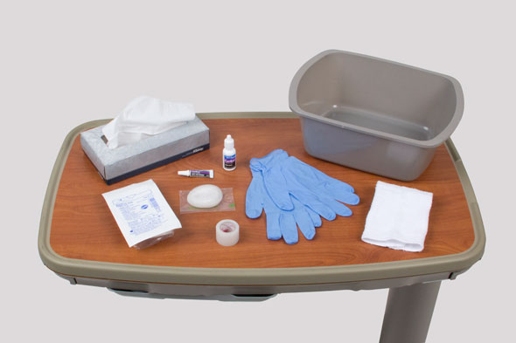
Administering Eye Medications

Slide 3
Safety
Ensure that the Six Rights of medication administration are followed: right medication, right dose, right patient, right route, right time, and right documentation.
When using eye drops or eye ointments, patients should not share medications with others, because the risk of transmitting infection is high.
When both eye drops and eye ointment are ordered, administer the drops first, wait 3 minutes, and then administer the ointment. This allows time for each medication to have an effect.

Slide 4
Mydriatics (agents used to dilate the pupils) will temporarily blur vision. Wearing sunglasses will reduce photophobia.
Caution patients receiving medications that paralyze the ciliary muscles of the eye (e.g., scopolamine, Isopto-Hyoscine, atropine, Isopto Atropine, and cycloplegics) not to drive or attempt to perform any activity that requires acute vision after receiving the medication.
Do not hyperextend the neck of a patient with a cervical spine injury.
Avoid applying eye medications directly onto the sensitive cornea, which has a rich supply of nerve fibers. Instead, instill medications into the conjunctival sac.

Slide 5
Equipment List for Administering Eye Medications
Prescribed medication
Clean gloves
Cotton ball or tissue
Basin
Washcloth and towel
Eye patch and tape (optional)

Slide 6
Preparation
Check the accuracy and completeness of the medication administration record (MAR) against the health care provider’s medication order.
Note the patient’s allergies.
Read carefully the manufacturer’s instructions for application or administration.
Observe the Six Rights of Medication Administration: right medication, right dose, right patient, right route, right time, and right documentation.

Slide 7
Note the eye being treated (right, left, or both) and the number of drops to instill.
Prepare medications for application. Check the medication label against the MAR two times.
Check the expiration date on the container or package.
If eyedrops are stored in refrigerator, allow them to come to room before giving them

Slide 8
Procedure Guideline for Administering Eye Medications
1. Verify the health care provider’s orders.
2. Provide for the patient’s privacy.
3. Perform hand hygiene.
4. Introduce yourself to the patient and family if present.

Slide 9
5. Identify the patient using two identifiers.
Compare these identifiers with the information in the patient’s medication administration record (MAR) or medical record.
6. Ask the patient if he or she has any allergies.

Slide 10
7. Before applying any eye medication, check the patient's MAR against the provider's orders.
During administration, follow the "Six Rights of Medication Administration."
Perform the third medication check at the patient’s bedside.
Compare the MAR or computer printout with the medication labels and with the patient’s name.
Check the expiration of the medication.

Slide 11
8. Discuss the purpose of each medication, its action, and possible adverse effects.
Allow the patient to ask questions about the drugs.
Patients who wish to self-instill medications may be allowed to do so under a nurse’s supervision (check agency policy).
Tell patients who are receiving eye drops (mydriatics) that vision will be blurred temporarily and that sensitivity to light may occur.

Slide 12
9. For all eye medications:
A. Perform hand hygiene and apply clean gloves.
B. Help the patient into a comfortable position. Ask the patient to lie supine or sit back in a chair with the neck slightly hyper-extended. Raise the bed and lower the side rail.

Slide 13
C. If drainage or crusting is present along the eyelid margins or inner canthus, gently wash it away.
Soak any dried crusts by holding a warm, damp washcloth or cotton ball over the eye for several minutes.
Always wipe from the inner canthus to the outer canthus using a clear corner of the cloth each time.
Do not scrub the eyelid.
D. Remove your gloves, and perform hand hygiene. Reapply clean gloves.

Slide 14
10. Instill eyedrops:
A. Using your non-dominant hand, hold a clean tissue or cotton ball on the patient's cheekbone, just below the lower eyelid.
Gently press downward with your thumb or forefinger against the bony orbit, exposing the conjunctival sac.
Never press directly against the patient’s eyeball.
B. Ask the patient to look up. Resting your dominant hand gently on the patient’s forehead, hold the filled medication eyedropper approximately 1 to 2 cm (½ to ¾ inch) above the conjunctival sac.

Slide 15
C. Drop the prescribed number of drops into the conjunctival sac.
D. If the patient blinks or closes his or her eye, causing the drops to land on the outer lid margins, repeat the procedure.
E. When administering drops that may have systemic effects, apply gentle pressure to the patient’s nasolacrimal duct with a clean tissue for 30-60 seconds per eye.
Avoid putting pressure directly on the patient’s eyeball. Ask the patient to close his or her eyes gently and briefly.
F. Dispose of used tissues in the proper trash receptacle. Remove your gloves, and perform hand hygiene

Slide 16
11. Instill eye ointment:
A. With the thumb of your nondominant hand, pull the patient’s eyelid down, exposing the conjunctival sac.
Have the patient look up.
Holding an applicator above the lower margin of the eyelid, apply a thin ribbon of ointment evenly along the inner edge of the lower eyelid on the conjunctiva, from the inner canthus to the outer canthus.

Slide 17
B. Have the patient close his or her eye and rub the lid gently with a cotton ball, using a circular motion, if doing so is not contraindicated.
C. If excess medication is on the eyelid, gently wipe it away, moving from the inner to the outer canthus.
D. Dispose of used tissues in the proper trash receptacle. Remove your gloves, and perform hand hygiene.

Slide 18
12. If the patient needs an eye patch, apply a clean one by placing it over the affected eye, so that the entire eye is covered. Tape the patch securely without applying pressure to the eye.
13. As part of your follow up care, encourage the patient to demonstrate self-administration of his or her eye medication. Reinforce teaching as needed.
14. Help the patient into a comfortable position, and place toiletries and personal items within reach.

Slide 19
15. Place the call light within easy reach, and make sure the patient knows how to use it to summon assistance.
16. To ensure the patient’s safety, raise the appropriate number of side rails and lower the bed to the lowest position.
17. Leave the patient’s room tidy.
18. Document and report the patient’s response and expected or unexpected outcomes.

Slide 20
Thank You

