Slide 1
Assisting with Walking Using Walkers, Canes and Crutches

Slide 2
Walking aids and standing frames
appliances /devices useful for mobility as well as stability purpose
for an individual who cannot walk and stand independently.
-useful for non-wt bearing ,partial wt bearing and full wt bearing gait pattern.
-Gives anterior and lateral stability
Purposes:
Increase area of support, maintain center of gravity over support area
Redistribute weight-bearing area

Slide 3
Reasons for using these device /indications:
Poor balance, Pain
Inability to bear weight on a LE due to # or other injury,
Paralysis involving one or both LEs or weakness
Amputation of a lower extremity.

Slide 4
General Principles
PT should be carefully evaluated in order to select the appropriate device to meet the pt’s needs.
PT must be aware of the pt’s total medical condition, weight-bearing status of the involved extremity when considering which type of device to use.
PT will need to determine the ROM of the extremities and the strength of the primary muscles required for ambulation.
PT must press downward on the gait device in order to move the body forward.
The scapular, shoulder, and elbow musculature supports the body’s weight while the non-affected lower extremity is moved forward. The finger flexors fold the hand-piece of the assistive gait device.

Slide 5
Assessments of pt
Strength of upper and lower limbs
Coordination
Stability
Improvement
Motivation
Age
Proproception
pain

Slide 6
Selection of gait devices
When choosing gait device, the PT considers the amount of support the pt needs and ability to manipulate the device.
The selection of device is based on the pt’s disability, coordination, and stability.
For example, you may have two Pts with the same type of fracture.
One of the pts may use crutches if h/se has adequate stability and coordination to safely use them.
The other pt may require a walker due to poor stability and coordination.
As the pt’s abilities improve, they may advance to device providing less stability and support for easier maneuverability.

Slide 7
Types of walking devices:
Walking devices are designed to improve the pt’s stability by increasing the base of support.
The categories of ambulation devices, in order from greatest to least amount of support, are:
Parallel bars,
Walkers,
Axillary crutches,
Forearm (Loftstrand) crutches,
Two canes, and
One cane.
All categories are adjustable and come in tall, adult, and child sizes.
Additionally, a special platform can be attached to walkers or axillary crutches for pts who are unable to bear weight through the hand, wrist, or forearm.

Slide 8
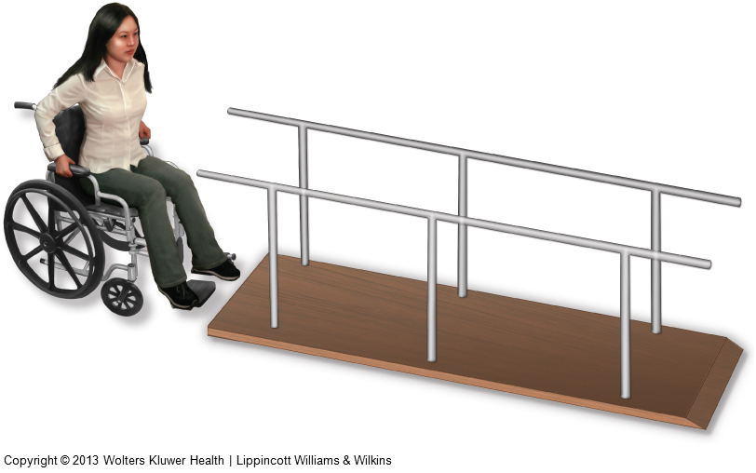
1) Parallel bars
Used when maximal Pt support and stability are required.
The gait pattern can be practiced in parallel bars and the fit of the assistive device can be checked.
The parallel bars limit mobility. So once the patient becomes proficient with the appropriate gait pattern, the pt must be progressed to another assistive gait device to be mobile.
The height needs to be adjusted to provide 15 to 20⁰ of elbow flxn when the pt is standing erect and is grasping the bars about 6 inches anterior to the hips

Slide 9
2) Walkers
provide maximum stability and support and allow the patient to be mobile.
are designed in many styles, but all have four legs.
Some may have two or four wheels.
Wider and more stable base of support, but slow gait (interfere smooth reciprocal gait)
For patients requiring maximum assistance with balance, uncoordinated

Slide 10
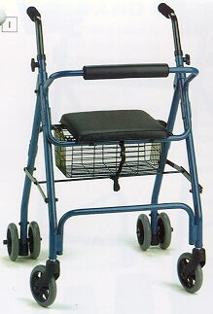
Walkers
A).Four wheel walking frame with axillary crutch and seat support [indoor use]
Has 4 wheel + axillary crutch +seat support.
Provides total support
Wheels are lockable
Foldable seat

Slide 11
B).Four wheel walking frame with axillary crutch support [indoor use]
Similar except seating
Designed for weak and unstable
Two wheels are lockable
Pt more able and stable
Level of support is decreased

Slide 12
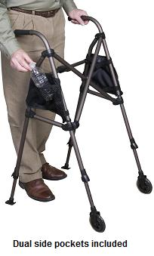
c)Two wheel walking frame with hand support [indoor use]
Provides support by hand & arm
Designed to ease forward motion

Slide 13
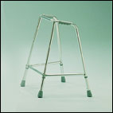
D).Standard 4-legged indoor walking frame for hand support
4 legs with rubber bumper
Provides support through hand & arm
Pt transfer wt through hands Joints between lateral and anterior support allows reciprocal arm swing
Allow ease forward

Slide 14
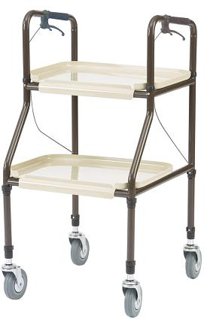
E).Standard 4-wheeled indoor walking frame for hand support
Similar support
Has container
No lateral joints
Some of them are self locking
Ease forward movement

Slide 15
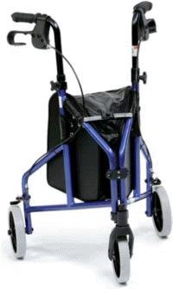
F)3-wheel out door walking frame
Provides support through hand & arm
3 wheel design makes it stable
2 back wheels manually operated brakes

Slide 16
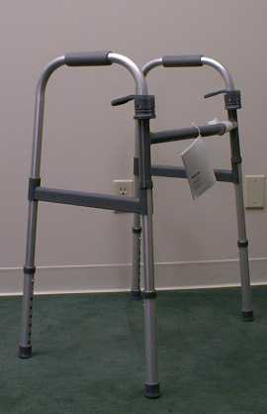
G).Foldable walker
Easily foldable
Easy to carry

Slide 17
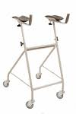
H).Gutter walker
Rigid walker additionally has forearm platform instead of hand grip
For pts with problem over wrist

Slide 18
Disadvantages of using walkers:
difficult to store and transport.
are very difficult to use on stairs.
reduce the speed of ambulation.
The patient is unable to use a normal gait pattern by using walker.
To properly fit a patient with a walker, adjust the height of the walker so that the patient has between 15 and 25 degrees of elbow flexion when grasping the handles of the walker.

Slide 19
Canes
For good arm and shoulder strength
Indoor and outdoor use
4 legged canes are used for pts who may not have enough strength
are used to compensate for impaired balance or to increase stability while ambulating.
There are several styles of canes but the standard is known as the J cane.
A cane is functional on stairs and in confined areas.
It is also easily stored and transported.

Slide 20
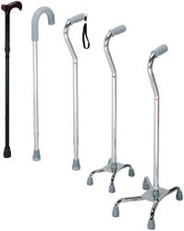
Canes

Slide 21
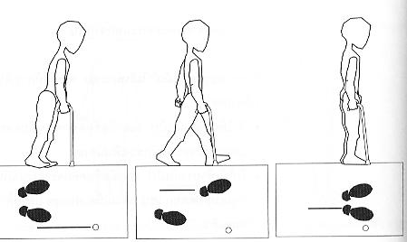

Slide 22
Disadvantage of a cane
It provides limited support due to its small base of support.
To fit a patient with a cane (measurement)
have the patient stand and place the can parallel to the lateral aspect of the tibia and femur.
Adjust the hand piece of the cane so it is level with the ulnar styloid process.
This will provide 15 to 25 degrees of elbow flexion when the patient grasps the handle of the cane.

Slide 23
Crutches
Types:
Designs (variety)
Advantage,
Disadvantage
Measurements
Pre Crutch training, crutch muscle, COG, LOG….
Gait patterns (crutch walking) NWB,PWB,FWB
Rules to use crutch
Going down stairs with crutch
Climbing up stairs with crutch

Slide 24
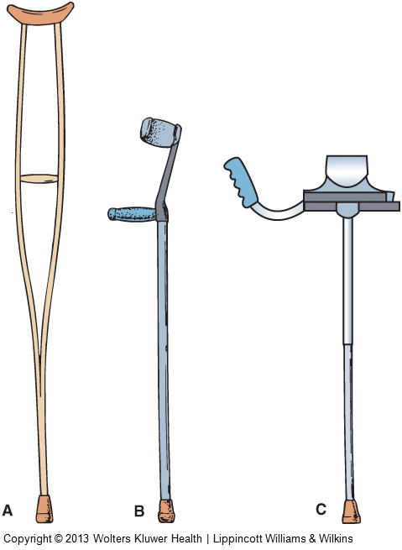
Types of crutches
Three types:
Axillary
Forearm/elbow
platform

Slide 25
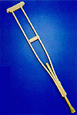
3) Axillary crutches
Used with patients who do not require as much stability or support as provided by a walker.
Allow the patient to perform a greater variety of gait patterns and ambulate at a faster pace.
Provides support through shoulder, axilla, arm and hand
Indoor and outdoor

Slide 26
Disadvantages of axillary crutches:
Are less stable than walker.
Improper use can cause injury to the neurovascular structures in the axillary region.
They require good standing balance by the patient.
Geriatric patient may fell insecure b/c they may not have the necessary upper- body strength to use axillary crutches.

Slide 27
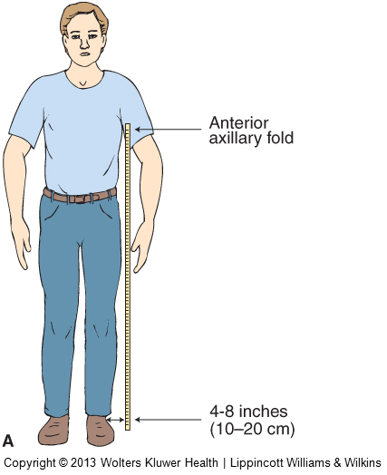
Axillary crutch measurement in standing position

Slide 28
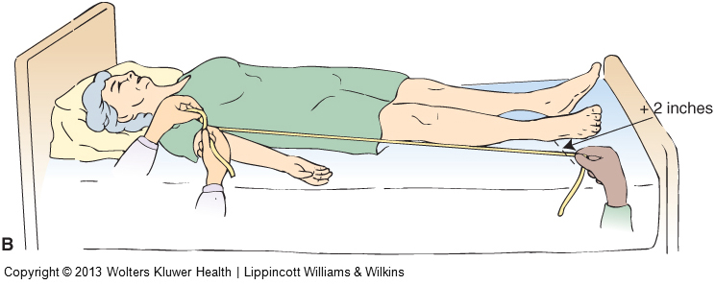
Axillary crutch measurement in supine position

Slide 29
Forearm crutches
are used when the patient need crutches permanently, or for long periods of time.
Using forearm crutches requires no more energy, increased oxygen consumption or heart rate than axillary crutches.
has the advantage of being easily stored and transferred.
no risk of injury to the neurovascular structures in the axillary region when using it
Weight transfers medio –laterally
Support for any lateral force

Slide 30
Disadvantages of forearm crutches:
Forearm crutches are less stable than a walker.
They require good standing balance and upper-body strength.
Geriatric patient sometimes feel insecure with these crutches.
b/c they may not have the necessary upper-body strength to use forearm crutches.

Slide 31
To fit the patient with forearm crutches:
have the patient stand with arms hanging loosely by the side.
Place the crutch parallel to the lateral aspect of the tibia and femur.
Adjust the height of the hand-piece so that it is level with the ulnar styloid process. This will insure the elbow is flexed between 15 and 25 degrees.
The top of the forearm cuff should be adjusted so that it is located 1 to 1.5 inches distal to the olecranon process of the elbow while the patient is grasping the hand-piece of the crutch with the wrist in neutral flexion-extension.

Slide 32
Axillary crutch measurements
Shoes off – pt supine lying
from apex of axilla to the lower margin of medial malleolus
Shoes on –pt supine lying
from 5cm below the apex of axilla to a point 2o cm lateral to the heel of the shoe
Axillary pad is placed 5cm below the axilla
Hand grip is at the level of greater trochanter
forearm/Elbow crutch measurement
from ulnar styloid process with elbow 15 degree flexion to the 20cm lateral to the heel of the shoes or may be to the heel

Slide 33
Pre-crutch training
Psychological state of the pt
Crutch muscles training
Balance of the pt
Psychological state
is training of the pt to get mental acceptance for the device/crutch
to use it and believe that his /her problem can be reduced by using that crutch.

Slide 34
Crutch muscles: the primary muscles involved are
Shoulder depressors, extensors and adductors
Elbow extensors
wrist extensors
Finger flexors
Hip extensors, abductors
Knee –extensors
Ankle plantar flexors and
Toe -flexors

Slide 35
Rules to use crutch
Don’t look down. Look straight ahead as you normally do when you walk.
Don’t use crutches if you feel dizzy or drowsy.
Don’t walk on slippery surfaces. Avoid snowy, icy, or rainy conditions
Don’t put any weight on the affected foot if your doctor has so advised.
Do make sure your crutches have rubber tips.
Do wear well-fitting, low-heel shoes
Do position the crutch hand grips correctly

Slide 36
Posture ,gravity and alignment
they affect the functioning of an orthosis /prosthesis
Alignment-state of being arranged inline with/parallel to something
posture-is alignment of body segment in spaces.
1-static posture - maintaining a position
- body segments are at rest
2-dynamic posture - posture in which body /its segments are moving.
in either of the cases to maintain upright/ erect posture the body must counteract the effect of gravity or other forces acting up on it

Slide 37
…Continued
effect of gravity on the body is typically countered by internal forces i e
the pull of muscles ,ligaments ,capsules and other soft tissues and bone pushing bone
the NS also plays critical role that
It must be capable of receiving , processing and interpreting information to provide appropriate output.
An intact NS provides a sense of proprioception and muscles contracting with the appropriate pattern and timing

Slide 38
LINE AND CENTER OF GRAVITY
Gravity is a predictable force
LOG or action line is always vertical , pointing towards the centre of the earth
The point of application for gravity is hypothetical in the centre mass of the object

Slide 39
Centre of gravity(COG)
the point where gravity appears to act.
the geometric centre of a symmetric object is the centre of gravity
for an asymmetric object the COG is the point around which the mass of the object is evenly distributed
think the COG as “ the balance point of an object”
in human being the COG lies anterior to S2 (sacrum bone)

Slide 40
the human body is made up of many movable segments.
each segments can be considered to have its own COG . if these segments were fixed in relation to each other the COG would not be changed as these segments were moved in spaces.
they are free to move in relation to each other as a result , the combined COG is not in fixed location
the mass of the segment remains the same therefore the force of gravity remains the same

Slide 41
Basic gait patterns
The selection of the proper gait pattern is dependent upon the patient’s
balance,
strength,
coordination,
functional needs, and
weight-bearing status.

Slide 42
Crutch-walking gaits: pattern of walking when ambulating with crutches
Point-the sum of the crutches and legs used when performing the gait
Four-point gait
Three-point gait
Two-point gait
Swing-through gait

Slide 43
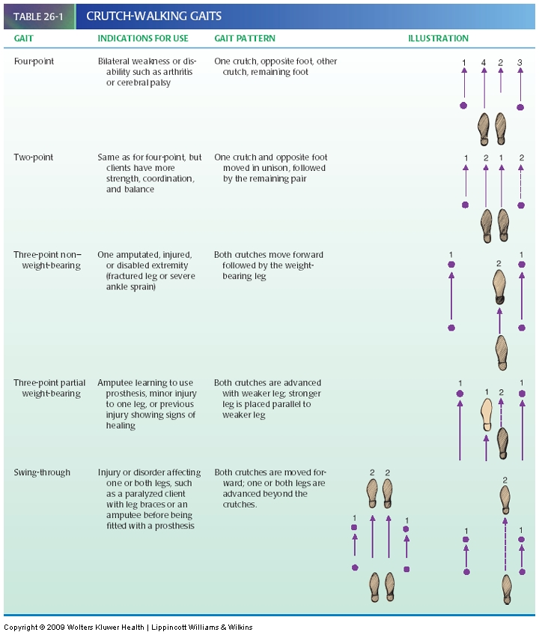

Slide 44
TYPES OF CRUTCH WALK
different types of crutch walking
all vary with how much weight is applied to the weak/injured foot.
Full weight Bearing
Non Weight Bearing
Partial Weight Bearing

Slide 45
Full weight bearing (FWB):
Walking with both feet on ground.
Strength of the affected leg is good
The affected leg can bear weight
The crutches are used for better stability
Progression can be to mobility with out crutches

Slide 47
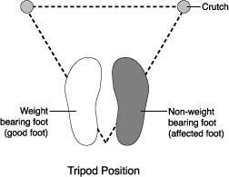
Non weight bearing gait (NWB)
Only the normal foot is bearing weight(in contact with the ground)
Pt stands with a triangular base
The weak foot/ankle is off the floor.
Indications of NWB
Pt with pop
Fracture
Early stage of ORIF

Slide 49
Point progression
is complexion of the gait pattern by arranging the points of contact with the ground according to the severity and the function needed.
Non weight bearing
3-point gait
a. Unaffected side crutch
b. Affected side crutch
c. Unaffected / good leg
2-Point gait
a .Unaffected & affected side crutch
b. Unaffected leg
Faster than 4-point gait but less stability

Slide 50
Non weight bearing
4-point gait (shadow walking)
Unaffected crutch
Affected crutch
Unaffected leg
Affected leg contacting the ground with out bearing any weight
Good stability - at least 3 point contact ground
Slowest, difficulty

Slide 51
Partial weight bearing (PWB)
4-point gait partial wt bearing
Affected side crutch
Unaffected side crutch
Affected leg
Unaffected leg
3-point gait partial wt bearing
Both crutches
Affected leg
Unaffected leg
2-point gait partial wt bearing
Both crutches with affected leg
Unaffected leg

Slide 52
Stair climbing up and climbing down of pts with crutches
Discuss the following questions in group
When a pt climbs up stairs what should go first in his/her step? crutch or leg ,good or bad ?
When climbing down stairs what should go down first? Crutch or leg , good or bad?

Slide 53
Rules for stair climbing
Good to heaven, bad to hell (both for the crutch and the foot)
Leg placed first while climbing up
Crutch placed first while climbing down

Slide 54
Climbing up stair
Place all your weight on the hand grips.
Start close to the bottom step.
Place the uninjured, healthy foot, on the first step.
Remember: “Good foot goes up first!” Keep the crutches with your weak side. Step up
Keep your body straight. Check your balance before proceeding.
Bring up your weak foot, keep the crutches with the weak side

Slide 55
Stair climbing rules for crutch users
Climbing up stairs
Climbing down stairs

Slide 56
Going down the stairs:
Start at the edge of the step. Keep your hips beneath you.
Slowly place the weight on the hand grips and bring the crutches with your weak side down first to the next step
As you proceed forward, bend at the hips and knees, this will help to prevent leaning too far forward. can cause falls.
Bring healthy foot to step below.
Check your balance before you proceed to the next step.

Slide 57
Thank You

