Slide 1
Psychosocial Aspects of Nursing in Caring an Adult Client

Slide 2
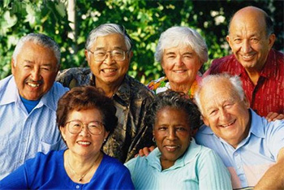
Introduction
The psychosocial maturity of elderly such as wisdom, creativity, spirituality and emotional out growth have shaped the world we now live
Elders are transmitters of knowledge of life experiences.
They help in crisis management and also roots of our society

Slide 3
Introduction
One consequence of the "graying" of the world's population is that all health care professionals will increasingly be providing services to older adults and their caregivers.
Because emotional health in older adults is a key ingredient to successful aging, nurses, social workers, mental health and medical professionals can play a key role in addressing these important areas in both community and structured care settings.

Slide 4
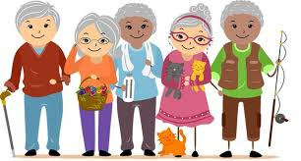
Psychosocial aspects related to elderly
Retirement
altered relationships with adult children
changes in housing
loss of valued possessions
loss of friends resulting from relocation or death
loss of spouse
loss of health and
loss of independence

Slide 5
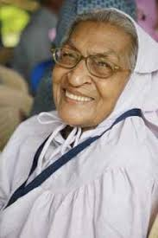
Sociological theories of ageing explain that the maintenance of social equilibrium is achieved by a mutually beneficial process of reciprocal withdrawal between society and older people. (Disengagement theory)
The older people remain psychologically and socially fit if they remain socially active. One’s self concept is affirmed through activities associated with various roles that the loss of roles in the old age negatively affects life satisfaction (Activity theory)

Slide 6
Psychosocial challenges of elderly

Slide 7
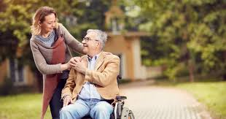
1. Chronic Disease
More than 50% of older adults have three or more chronic diseases.
Multi-morbidity is associated with higher rates of death, disability, adverse effects, institutionalization, use of healthcare resources, and poorer quality of life.
Evidence-based data supports that early identification and early intervention for geriatric syndromes is a critical prevention strategy for the older person.

Slide 8
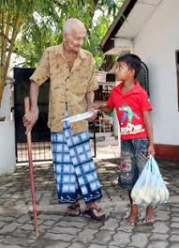
2. Family changes
The family unit is a major source of satisfaction for older adults as they enjoy the love, companionship, and achievement of spouse, children, and grandchildren.
Their role within the family has changed multiple times in their lifetime.
In old age they are cared for by their children versus the other way around.

Slide 9
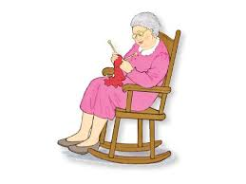
3. Retirement:
This can be a difficult time because our society places so much emphasis on what a person does.
Often one’s work gives social position and influence, is a source of social contacts, and provides a feeling of satisfaction from productivity.

Slide 10
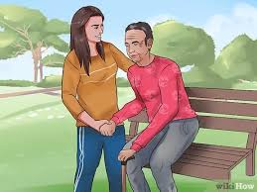
4. Awareness of one’s own mortality
Not only do spouses die—but friends do also. Older adults may also experience health decline.
Often, older adults review the significance of their life through reminiscences. They love to tell stories of life events. They need to be encouraged to tell stories. They often are faced with multiple losses at one time.

Slide 11
5. Widowhood:
This affects more women than men, as women tend to live longer.
Adjusting to the loss of someone you have shared life with is often difficult.
Many older women have lived family-oriented lives and have been dependent on their husbands.
They find themselves in new roles—such as financial manager—that they need to learn.

Slide 12
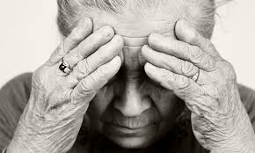
6. Declining physical reserves
As all of us age, the wear and tear on our bodies causes changes to occur. Fatigue sets in. Our responses become slower, and our appearance changes.
Chronic illness affects body systems. The fear of loss of independence is great. Being independent is a strong value for most.

Slide 13
7. Shrinking social world for some:
Loneliness commonly occurs as a spouse or friend becomes ill or dies. Children and grandchildren are often very busy and may live at a distance.
Often older adults choose not to drive—further limiting their socializing.
Senses, such as hearing and seeing, diminish, making communication difficult.

Slide 14
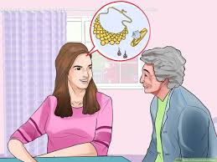
8. Changes in income:
Often retirement income is less than half the income earned when the person was fully employed.
Social security income for many is the main source of income. If a spouse dies, the income is usually further decreased.
This decrease can cause significant adjustments in a person’s social and leisure activities.

Slide 15
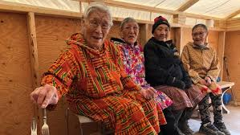
It affects to psychosocial functions causing;
Mood disorders
Anxiety
Delirium
Dementia
Agression
Substance abuse
Sleep disorders
Pain
Eating disorders
Abuse and neglect

Slide 16
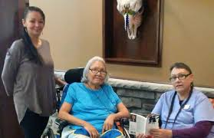
Nurses to promote Health aging
Health aging is the ability to continue to function mentally, physically, socially and spiritually as the body slows down its process

Slide 17
Principles of geriatric nursing for healthy aging
Continuous process of change and adaptation.
Self defined and individualistic.
Slowing down of body processes.
Acceptance and movement towards death.
Desire to continue to actively participate in life processes.
Ability to function physically, cognitively and socially.
Self assessment and redefinition of self and abilities.

Slide 18
Ways to improve psychosocial aspects of elderly

Slide 19
To improve self esteem
Allow elderly to make choices whenever possible.
Encourage elderly to do as much as possible for themselves.
Modify environment that suits elderly to perform self care activities independently.
Avoid being over protective or directive to prevent the feeling of impotent or child like.
Respect older adult’s rights to refuse.
Explore feelings and concerns to improve self worth.
Demonstrate acceptance.
Focus on abilities and not disabilities to promote self worth.
Absence of self worth leads to despair and hopelessness. Erickson stressed the importance of seeing value in the life stories of older adults.
Provide opportunities for reminiscence because it provides recognition of previous successes.

Slide 20
To strengthen familial roles and relationships
Assess the interaction between family members.
Encourage family members to verbalize their feelings independently and teach positive coping.
Assist family members in identifying personal and family strengths.
Encourage the family members to assist in elderly care.
Assist families in identifying the factors that are interfering with normal interactions.
Making the elderly a vital component of the family system.

Slide 21
To cope with stress
Encourage older adults to verbalize their feelings.
Assist in identifying the personal strengths and previously successful coping strategies.
Progressive relaxation: Tighten and relax muscles starting at the feet and working upward through the body.
Self hypnosis: Place oneself in a trance like state.
Imagery: To think of a calm, peaceful setting and enjoying the experience.
Meditation: To shut out the external stimuli and focus on calming the thoughts.

Slide 22
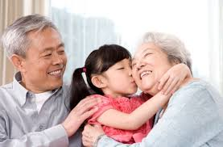
To encourage family to support the adults
For e.g. Retirement :- develop new skills, use time for hobbies and personal pursuits and get involved with meaningful volunteer activities.
Reduced income:-take advantage of discounts for seniors.
Functional limitations:- adapt the environment to ensure safety and optimal functional status, take advantage of assistive devices and equipments and accept help when necessary.

Slide 23
Role of the Nurse
Gerontological Nursing interventions are directed towards enhancing self esteem, promoting a sense of control, fostering self supports and assisting them with effective use of coping mechanisms.
Nurses are providers of health education and other health promotional intervention to improve quality of life, enable each individual to function at the highest possible level of social and emotional wellness.

Slide 24
Role of the Nurse
Nurses are prepared with unique skills that support this wellness by assessing for the strengths of the family system and assuring that appropriate care is in place.
Addressing the identified needs from a proactive approach allows for prevention of predictable risks and improved disease management.

Slide 25
Value Based Priorities
Maintain a person-in-environment perspective in understanding human functioning and well-being.
Respect and promote older adults’ rights to dignity and self determination.
Attend to maintaining quality of life for older adults and family systems.
Promote social justice, including reducing barriers to wellbeing in later life.
Promote older adults’ coping and problem-solving capabilities.
Committed to person-centered, team approach in conducting, implementing and evaluating assessments.
Advocate for agency practice in person/family centered assessments consistent with social work values.

Slide 26
Thank You

