Slide 1
Surgical Gloves, Gown, Mask and Cap and Sterile Field Preparations

Slide 2
Guidance for the Selection and Use of Personal Protective Equipment (PPE) in Healthcare Settings

Slide 3
Topics
Personal Protective Equipment
Types of PPE Used in Healthcare Settings
Key Points About PPE
Standard Precautions

Slide 4
Personal Protective Equipment Definition
“specialized clothing or equipment worn by an employee for protection against infectious materials”
Notes:
GUIDANCE FOR THE SELECTION AND USE OF PERSONAL PROTECTIVE EQUIPMENT (PPE) IN HEALTHCARE SETTING
Personal protective equipment, or PPE, as defined by the Occupational Safety and Health Administration, or OSHA, is “specialized clothing or equipment, worn by an employee for protection against infectious materials.
The goal of this program is to improve personnel safety in the healthcare environment through appropriate use of PPE.
The objectives of this program are to provide information on the selection and use of PPE in healthcare settings and to allow time for participants to practice the correct way to don and remove PPE
All of the PPE listed here prevent contact with the infectious agent, or body fluid that may contain the infectious agent, by creating a barrier between the worker and the infectious material. Gloves, protect the hands, gowns or aprons protect the skin and/or clothing, masks and respirators protect the mouth and nose, goggles protect the eyes, and face shields protect the entire f

Slide 5
Types of PPE Used in Healthcare Settings
Gloves – protect hands
Gowns/aprons – protect skin and/or clothing
Masks and respirators– protect mouth/nose
Respirators – protect respiratory tract from airborne infectious agents
Notes:
All of the PPE listed here prevent contact with the infectious agent, or body fluid that may contain the infectious agent, by creating a barrier between the worker and the infectious material. Gloves, protect the hands, gowns or aprons protect the skin and/or clothing, masks and respirators protect the mouth and nose, goggles protect the eyes, and face shields protect the entire face.
The respirator, has been designed to also protect the respiratory tract from airborne transmission of infectious agents. We’ll discuss this in more detail later.

Slide 6
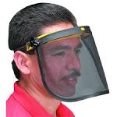
Types of PPE Used in Healthcare Settings
Goggles – protect eyes
Face shields – protect face, mouth, nose, and eyes
Notes:
All of the PPE listed here prevent contact with the infectious agent, or body fluid that may contain the infectious agent, by creating a barrier between the worker and the infectious material. Gloves, protect the hands, gowns or aprons protect the skin and/or clothing, masks and respirators protect the mouth and nose, goggles protect the eyes, and face shields protect the entire face.
The respirator, has been designed to also protect the respiratory tract from airborne transmission of infectious agents. We’ll discuss this in more detail later.

Slide 7
Key Points About PPE
Don before contact with the patient, generally before entering the room
Use carefully – don’t spread contamination
Remove and discard carefully, either at the doorway or immediately outside patient room; remove respirator outside room
Immediately perform hand hygiene
Notes:
There are four key points to remember about PPE use. First, don it before you have any contact with the patient, generally before entering the room. Once you have PPE on, use it carefully to prevent spreading contamination. When you have completed your tasks, remove the PPE carefully and discard it in the receptacles provided. Then immediately perform hand hygiene before going on to the next patient.

Slide 8
Sequence* for Donning PPE
Gown first
Mask or respirator
Goggles or face shield
Gloves
*Combination of PPE will affect sequence – be practical
Notes:
The gown should be donned first. The mask or respirator should be put on next and properly adjusted to fit; remember to fit check the respirator. The goggles or face shield should be donned next and the gloves are donned last. Keep in mind, the combination of PPE used, and therefore the sequence for donning, will be determined by the precautions that need to be taken.

Slide 9
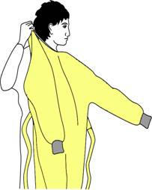
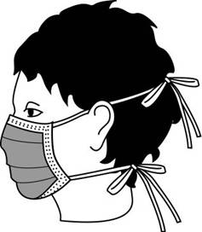
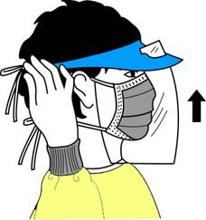
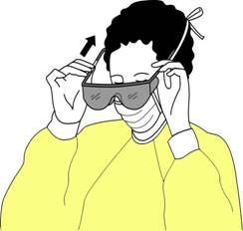
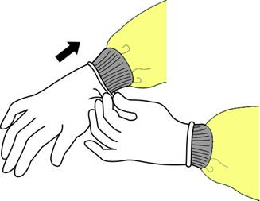
Donning PPE

Slide 10
How to Safely Use PPE
Keep gloved hands away from face
Avoid touching or adjusting other PPE
Remove gloves if they become torn; perform hand hygiene before donning new gloves
Limit surfaces and items touched
Notes:
In addition to wearing PPE, you should also use safe work practices. Avoid contaminating yourself by keeping your hands away from your face and not touching or adjusting PPE. Also, remove your gloves if they become torn and perform hand hygiene before putting on a new pair of gloves. You should also avoid spreading contamination by limiting surfaces and items touched with contaminated gloves.

Slide 11
“Contaminated” and “Clean” Areas of PPE
Contaminated – outside front
Areas of PPE that have or are likely to have been in contact with body sites, materials, or environmental surfaces where the infectious organism may reside
Clean – inside, outside back, ties on head and back
Areas of PPE that are not likely to have been in contact with the infectious organism
Notes:
To remove PEP safely, you must first be able to identify what sites are considered “clean” and what are “contaminated.” In general, the outside front and sleeves of the isolation gown and outside front of the goggles, mask, respirator and face shield are considered “contaminated,” regardless of whether there is visible soil. Also, the outside of the gloves are contaminated.
The areas that are considered “clean” are the parts that will be touched when removing PPE. These include inside the gloves; inside and back of the gown, including the ties; and the ties, elastic, or ear pieces of the mask, goggles and face shield.

Slide 12
Sequence for Removing PPE
Gloves
Face shield or goggles
Gown
Mask or respirator
Notes:
The sequence for removing PPE is intended to limit opportunities for self-contamination. The gloves are considered the most contaminated pieces of PPE and are therefore removed first. The face shield or goggles are next because they are more cumbersome and would interfere with removal of other PPE. The gown is third in the sequence, followed by the mask or respirator.

Slide 13
Where to Remove PPE
At doorway, before leaving patient room or in anteroom*
Remove respirator outside room, after door has been closed*
* Ensure that hand hygiene facilities are available at the point needed, e.g., sink or alcohol-based hand rub
Notes:
The location for removing PPE will depend on the amount and type of PPE worn and the category of isolation a patient is on, if applicable. If only gloves are worn as PPE, it is safe to remove and discard them in the patient room. When a gown or full PPE is worn, PPE should be removed at the doorway or in an anteroom. Respirators should always be removed outside the patient room, after the door is closed. Hand hygiene should be performed after all PPE is removed.

Slide 14
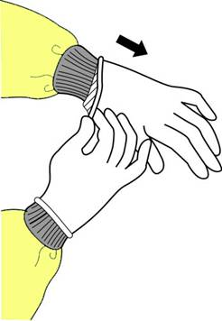
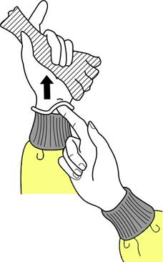
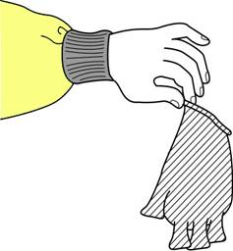
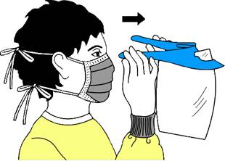
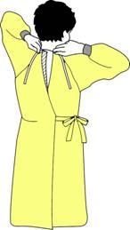
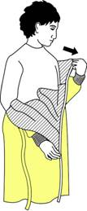
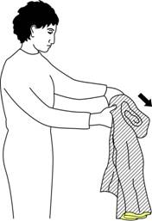
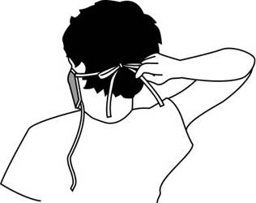
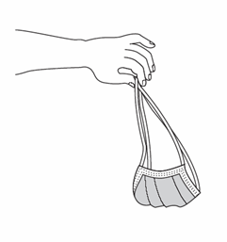
How to Remove How to Remove

Slide 15
Standard Precautions
Previously called Universal Precautions
Assumes blood and body fluid of ANY patient could be infectious
Recommends PPE and other infection control practices to prevent transmission in any healthcare setting
Decisions about PPE use determined by type of clinical interaction with patient
Notes:
Standard Precautions is an outgrowth of Universal Precautions. Universal Precautions was first recommended in 1987 to prevent the transmission of bloodborne pathogens to healthcare personnel. In 1996, the application of the concept was expanded and renamed “Standard Precautions.” Standard Precautions is intended to prevent the transmission of common infectious agents to healthcare personnel, patients and visitors in any healthcare setting. During care for any patient, one should assume that an infectious agent could be present in the patient’s blood or body fluids, including all secretions and excretions except tears and sweat. Therefore appropriate precautions, including use of PPE, must be taken. Whether PPE is needed, and if so, which type, is determined by the type of clinical interaction with the patient and the degree of blood and body fluid contact that can be reasonably anticipated and by whether the patient has been placed on isolation precautions such as Contact or Droplet Precautions or Airb

Slide 16
Standard Precautions FOR PPE
Gloves – Use when touching blood, body fluids, secretions, excretions, contaminated items; for touching mucus membranes and nonintact skin
Gowns – Use during procedures and patient care activities when contact of clothing/ exposed skin with blood/body fluids, secretions, or excretions is anticipated
Notes:
Under Standard Precautions, gloves should be used when touching blood, body fluids, secretions, excretions, or contaminated items and for touching mucous membranes and nonintact skin. A gown should be used during procedures and patient care activities when contact of clothing and/or exposed skin with blood, body fluids, secretions, or excretions is anticipated. Aprons are sometimes used as PPE over scrubs, such as in hemodialysis centers when inserting a needle into a fistula.

Slide 17
Standard Precautions for PPE
Mask and goggles or a face shield – Use during patient care activities likely to generate splashes or sprays of blood, body fluids, secretions, or excretions
Notes:
Mask and goggles or a face shield should be used during patient care activities that are likely to generate splashes and sprays of blood, body fluids, secretions, or excretions.

Slide 18
Donning and Doffing PPE

Slide 19
Donning and doffing of PPE
Donning and doffing is the practice of putting on and removing personal protective equipment.
Donning refers to putting on personal protective equipment.
Doffing refers to removing personal protective equipment.

Slide 20
Donning a surgical or cloth mask
Wash hands with soap and water or apply hand sanitizer before donning a mask.
Place mask on face with ear loops over ears.
The mask should cover your nose and mouth with no gaps between the mask and your face.
Wash hands with soap and water or apply hand sanitizer.
Avoid touching the mask while wearing it.

Slide 21
Doffing a surgical or cloth mask
Wash hands with soap and water or apply hand sanitizer.
Use the ear loops to remove the mask avoiding touching the front of the mask or your face.
Wash hands with soap and water or apply hand sanitizer.
Note: If the mask was worn during an encounter with another person who displayed obvious signs of illness, discard the mask in the trash.

Slide 22
Reusing a surgical or cloth mask
If using a surgical or cloth mask and following social distancing practices, the likelihood of the mask being contaminated is very low.
Wash hands with soap and water or apply hand sanitizer.

Slide 23
Remove mask by holding the ear loops.
After removing surgical facemask, visually inspect for contamination, distortion in shape or form. Discard in trash if soiled, torn, or saturated. If not place in paper bag. For a cloth face mask, place in paper bag and launder.
Carefully store surgical mask in an unsealed bag labeled with your name on it.
Wash hands with soap and water or apply hand sanitizer.

Slide 24
Procedures for donning safety glasses
Wash hands with soap and water or apply hand sanitizer before donning safety glasses.
Remove the safety glasses from package or storage container.
3. Place safety glasses directly on your face. Do not set the safety glasses on surfaces.

Slide 25
Procedures for doffing safety glasses
Wash hands with soap and water or apply hand sanitizer. If wearing gloves, remove gloves before removing safety glasses.
Remove safety glasses. Avoid touching your eyes and face.
Clean safety glasses with soap and water solution. Let dry before storing them.
Place safety glasses in clean plastic container or Ziploc bag for reuse.

Slide 26
Procedures for donning gloves
Wash hands with soap and water or apply hand sanitizer before donning gloves.
Select properly sized gloves.
Don one glove per hand.
Inspect gloves for any tears or holes and replace gloves if any defects are detected.

Slide 27
Procedures for doffing gloves
Grasp the outside edge near your wrist.
Peel away from your hand, turning the glove inside- out.
Hold in opposite gloved hand.
Slide ungloved finger under the wrist of the remaining glove.
Peel off from inside, creating a bag for both gloves.
Discard gloves in the garbage.

Slide 28
Thank You

